Slide 1
Debugging Microservices
Idit Levine founder & ceo, solo.io

Slide 2
Debugging microservices applications is hard
The problem:

Slide 3
The problem
A monolithic application consists of a single process
An attached debugger allows viewing the complete state of the application during runtime
A microservices application consists of potentially hundreds of processes
Is it possible to get a complete view of the state of a such application?!

Slide 4
The problem

Slide 5
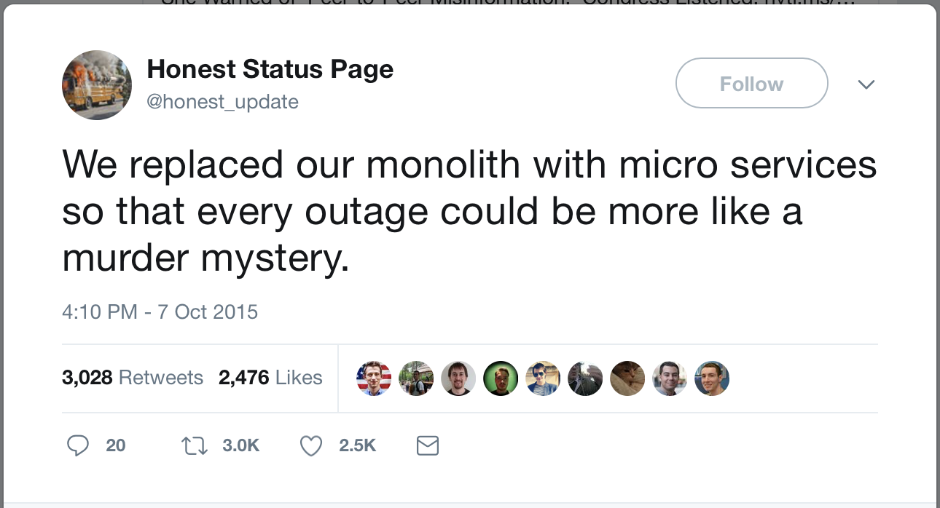
The problem

Slide 6
OpenTracing
Solution I

Slide 7
OpenTracing
assign a unique identifier to each request at the edge service
store it in a context object, along with other metadata
propagate the context across process boundaries (in-band)
baggage is arbitrary K/V
capture timing, events, tags and collect them out of band (async)
re-assemble the call tree from the storage for the UI
Edge service
Unique ID → {context}
A
{context}
{context}
B
E
{context}
{context}
C
D

Slide 8
OpenTracing
Edge service
Unique ID → {context}
A
A
{context}
B
{context}
B
E
TRACE
C
{context}
{context}
D
C
D
E
SPANS

Slide 9
OpenTracing Architecture
spans - basic unit of timing and causality. can be tagged with key/value pairs. logs - structured data recorded on a span.
span context - serializable format for linking spans across network boundaries. carries baggage, such as a request and client IDs.
tracers - anything that plugs into the OpenTracing API to record information. zipKin, jaeger & lightstep. but also metrics (Prometheus) and logging.

Slide 10
OpenTracing
OpenTracing is a consistent, expressive, vendor-neutral APIs for popular platforms, OpenTracing makes it easy for developers to add (or switch) tracing implementations with an O(1) configuration change.

Slide 11
OpenTracing
Demo

Slide 12
OpenTracing uses
logging - easy to output to any logging tool, even from OSS components.
metrics/alerting - measure based on tags, span timing, log data.
context propagation - use baggage to carry request and user ID’s, etc.
critical path analysis - drill down into request latency in very high fidelity.
system topology analysis - identify bottlenecks due to shared resources.

Slide 13
OpenTracing uses
openTracing does not provide run-time debugging
openTracing requires wrapping and changing the code
no holistic view of the application state – can only see what was printed
the process (repeatedly modify the application and test) is expansive
Impossible to change variable values in runtime
logging and printing results in performances overhead

Slide 14
Squash
Solution II

Slide 15
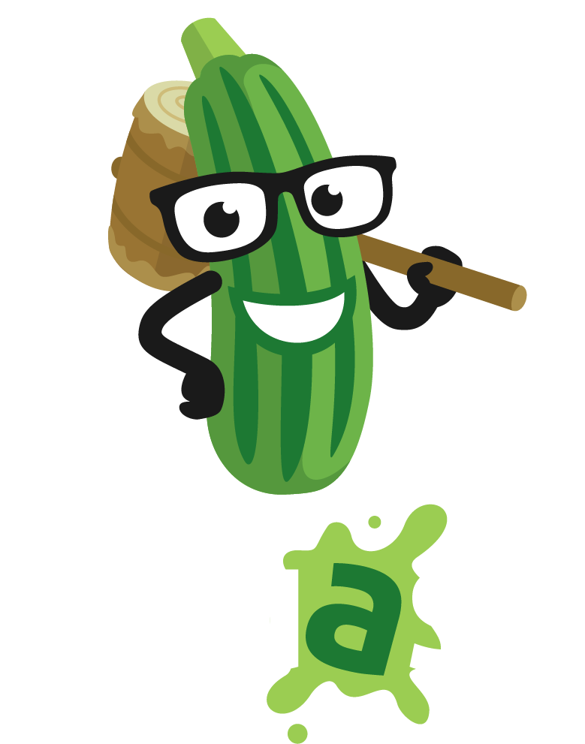
Squash
Squash brings the power of modern popular debuggers to developers of microservices apps that run on container orchestration platforms.
Squash bridges between the orchestration platform (without changing it) and IDE.
With Squash, you can:
Live debugging cross multi microservices
Debug container in a pod
Debug a service
Set breakpoints
Step through the code
View and modify values of variables
and more ...

Slide 16
Squash
Demo

Slide 17
Squash Architecture
Squash server: holds the information about the breakpoints for each application, orchestrates and controls the squash clients. Squash server deploys and runs on Kubernetes
Squash client: deploys as daemon set on Kubernetes node. The client wraps as docker container, and also contains the binary of the debuggers.
Squash User Interface: squash uses IDEs as its user interface. After installing the Squash extension, Squash commands are available in the IDE command palette.
What vegetable scares all the bugs? Squash!”
(one of my 8-year old daughter's favorite riddles)

Slide 18
Squash Architecture: vs code extension
vs code extension ➜ kubectl to present the user pod/container/debugger options
vs code extension ➜ Squash server with debug config (pod/container/debugger /breakpoint) ➜ waits for debug session
vs code extension ➜ connects to the debug server & transfers control to the native debug extension.

Slide 19
Squash Architecture: Squash Server
vs code extension ➜ Squash server
Squash server ➜ relevant Squash client with debug config (pod/container/debugger /breakpoint)
Squash server ➜ waits for debug session

Slide 20
Squash Architecture: Squash Client
Squash server ➜ Squash client
Squash client ➜ container runtime interface (to obtain the container host pid)
Squash client ➜ runs the debugger, attaches it to the process in the container, and sets the application breakpoints
Squash client ➜ return debug session.

Slide 21
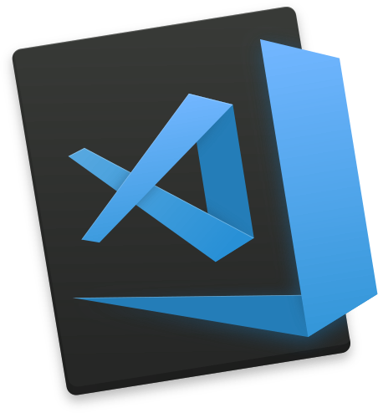
Squash high level Architecture
IP [y]:
IPython
GDB
The GNU Project
Debugger
Platforms
IDEs
Debuggers

Slide 22
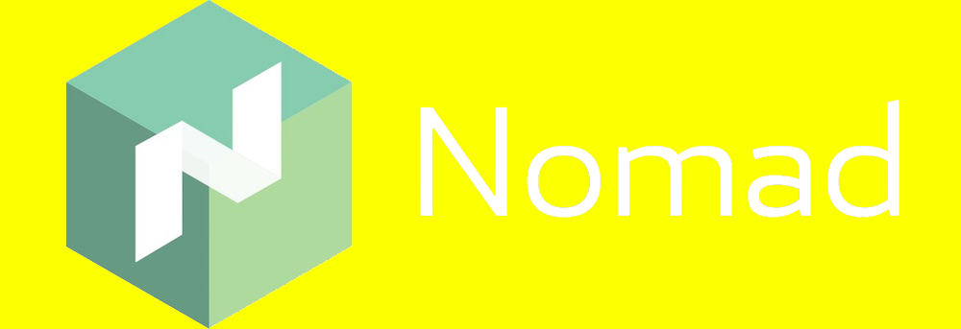
Squash high level Architecture
IP [y]:
IPython
GDB
The GNU Project
Debugger
Platforms
IDEs
Debuggers

Slide 23
Squash: open source project
We are looking for community help to add support for more debuggers, platforms and IDEs.
Check out at github: github.com/solo-io/squash

Slide 24
Service mesh
Solution III

Slide 25
Service Mesh
Service mesh data plane:
Touches every packet/request in the system. Responsible for service discovery, health checking, routing, load balancing, authentication/authorization, and observability.
Service mesh control plane:
Provides policy and configuration for all the running data planes in the mesh. Does not touch any packets/requests in the system. The control plane turns all of the data planes into a distributed system.

Slide 26
Envoy – data plane
The network should be transparent to applications. When network and application problems do occur it should be easy to determine the source of the problem.
Out of process architecture: developers focus on business logic
Modern C++11 code base: Fast and productive.
L3/L4 filter architecture: Can be used for things other than HTTP (TCP proxy at its core)
HTTP L7 filter architecture: Make it easy to plug in different functionality.
HTTP/2 first! (Including gRPC and a nifty gRPC HTTP/1.1 bridge).
Service discovery and active health checking.
Advanced load balancing: Retry, timeouts, circuit breaking, rate limiting, shadowing, etc.
Best in class observability: stats, logging, and tracing.
Edge proxy: routing and TLS.

Slide 27
control plane
Pilot: responsible for the lifecycle of Envoy instances deployed across the Istio service mesh. Pilot exposes APIs for service discovery, dynamic updates to load balancing pools and routing tables.
Mixer: provides Precondition Checking (authentication, ACL checks and more), Quota Management and Telemetry Reporting.
Istio-Auth enhance the security of microservices and their communication without requiring service code changes.

Slide 28
Service mesh, OpenTracing, and Squash
Towards an integrated solution

Slide 29
The whole solution
Step 1:
vs code extension ➜ Squash server creating a debug config (service & image) and wait for the debug session to connect.
Step 2:
envoy gets a curl request with squash header
Step 3:
➜ envoy ask Squash server to debug itself and wait for the debug session.
1
4
3
5
2

Slide 30
The whole solution
Step 4:
Squash server ➜ Squash client
Squash client ➜ container runtime interface (to obtain the container host pid)
Squash client ➜ runs the debugger, attaches it to the process in the container, and sets the application breakpoints
Squash client ➜ return debug session.
Step 5:
vs code extension ➜ connects to the debug
server & transfers control to the native debug extension.
envoy resume traffic to the app
1
4
3
5
2

Slide 31
Service Mesh
Demo

Slide 32
Hybrid apps
vision

Slide 33
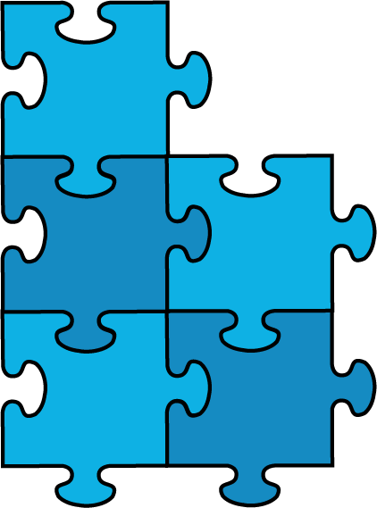
The problem: disparate ecosystems, hard transition
Monolithic Apps
Microservices
Serverless
Enterprise faces 4 main problems in adopting innovative architectures:
Insolation between brown and green field
Transition is lengthy and diverts essential personnel from core mission
Duplicate redundant tools
Requires silo teams
Puppet
Kubernetes
AWS 𝝀
SOA
debuggers
microservices
Squash
Event-driven
Event-driven
Splunk
OpenTracing
X-RAY

Slide 34
The vision: hybrid app
Monolithic Apps
Microservices
Serverless
Puppet
Kubernetes
AWS 𝝀
Access all available functions, the smallest unit of compute in all architectures

Slide 35
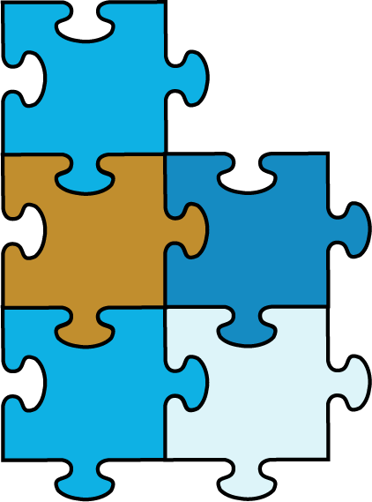
The vision: hybrid app
Monolithic Apps
Microservices
Serverless
Hybrid app
Puppet
Kubernetes
AWS 𝝀
Solo gloo
Access all available functions, the smallest unit of compute in all architectures
Provide a unified ecosystem, allowing the IT team
To seamlessly combine existing functionalities
Debug, and log applications using a single toolbox

Slide 36
The solution in 3 steps
Break the applications into functions, the universally minimal unit of computing
Enable assembly of functions into hybrid apps
Provide a unified ecosystem for debugging of hybrid apps - Squash
Notes:
2-5 slides, including demo
Why now?

Slide 37
The Function Gateway
Introducing

Slide 38
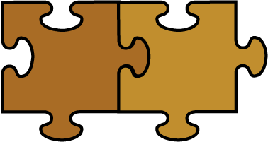
Step 1. Breaking the ecosystem into functions
Request
Emit
Function discovery
Enhancing Envoy:
- Support for AWS lambda, Google functions, OPENAPI functions
Extendable language for routing to functions
Customization tool
Kubernetes Ingress
Kubernetes Compatible
Gloo
Proxy (Envoy)
Plugins
Glooctl
Filters: functions, Transformation, …
Platform support
Notes:
Function Discovery service
gloo – function gateway
Envoy
New Envoy filters: aws lambda, google functions, Azure functions
Modify envoy (through filters) to support everything on the function level.
Kubernetes Ingress controller
Event gateway – starting with nats and nats streaming (import from serverless world)
Support istio out of the box – but do not have to be used.
Plugable (secret, config, endpoint discovery)
Plugable - can extend the laungue, filter & plugin (framework)
The tool – a tool to build gloo functions gateway (not everyone need all the feature)

Slide 39
Step 2. Building hybrid apps
Request
Emit
Kubernetes Compatible
Gloo
Proxy (Envoy)
Allows adding new functionalities as monolithic, microservices or serverless
Permits gradual migration from monolithic to microservices or serverless
Facilitates reuse of existing code
Plugins
Glooctl
Filters: functions, Transformation, …
Platform support
Hybrid app
+
/2
calc.com/add
calc.com/sub
calc.com/mul
calc.com/div
-
×
÷
On prem
Google cloud
AWS
Fluent cross-cloud hybrid apps
Notes:
2-5 slides, including demo
Why now?

Slide 40
Step 3. unified ecosystem for debugging
Request
Emit
Kubernetes Compatible
Gloo
Proxy (Envoy)
Allows adding new functionalities as monolithic, microservices or serverless
Permits gradual migration from monolithic to microservices or serverless
Facilitates reuse of existing code
Plugins
Glooctl
Filters: functions, Transformation, …
Platform support
Hybrid app
+
/2
calc.com/add
calc.com/sub
calc.com/mul
calc.com/div
-
×
÷
On prem
Google cloud
AWS
Fluent cross-cloud hybrid apps
Notes:
2-5 slides, including demo
Why now?

Slide 41
Gloo suite
The Function Gateway
Extend Gloo’s
configuration language
Building, deploying and adding
features to Gloo
Command-line interface
for configuring Gloo
Code: http://www.github.com/solo-io
Docs: http://gloo.solo.io
Debug hybrid app
Notes:
Function Discovery service
gloo – function gateway
Envoy
New Envoy filters: aws lambda, google functions, Azure functions
Modify envoy (through filters) to support everything on the function level.
Kubernetes Ingress controller
Event gateway – starting with nats and nats streaming (import from serverless world)
Support istio out of the box – but do not have to be used.
Plugable (secret, config, endpoint discovery)
Plugable - can extend the laungue, filter & plugin (framework)
The tool – a tool to build gloo functions gateway (not everyone need all the feature)

Slide 42
Hybrid app
Demo

Slide 43
Happy glooing & squashing !
the solo team
Visit us: www.solo.io
Github: www.github.com/solo-io
Twitter: @idit_levine
Notes:
10-15 slides
Will be shared
Equal weight to product and market (don’t get lost in demo)
Know your audience (what they invest in, relevant current investments)
Standalone as pdf

