Slide 1
JDK 9: Mission Accomplished What Next For Java?
Simon Ritter
Deputy CTO, Azul Systems

Slide 2
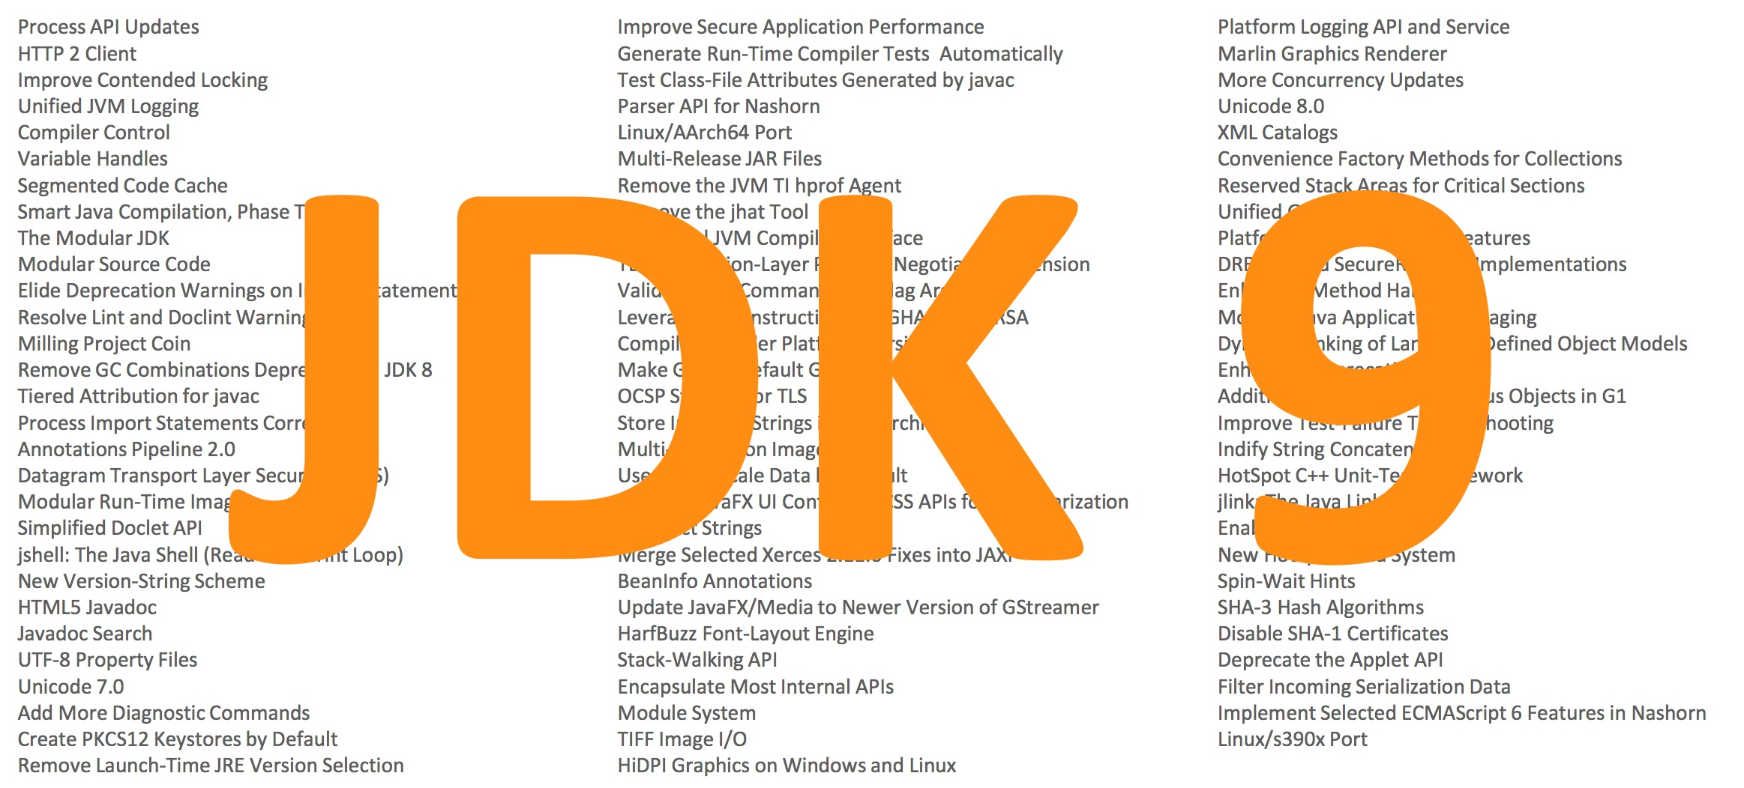
JDK 9: Big And Small Changes

Slide 3
Java Platform Module System (JPMS)
The core Java libraries are now a set of modules (JEP 220)
97 modules: 28 Java SE, 8 JavaFX, 59 JDK, 2 Oracle
Most internal APIs now encapsulated (JEP 260)
sun.misc.Unsafe
Some can be used with command line options
Modular source code (JEP 201)
JDK source code re-organised to support modules

Slide 4
Migrating Applications to JPMS
Initially, leave everything on the classpath
Anything on the classpath is in the unnamed module
All packages are exported
The unnamed module depends on all modules
Migrate to modules as required
Try automatic modules
Move existing jar files from classpath to modulepath

Slide 5
Reversing Encapsulation
"The Big Kill Switch" to turn off encapsulation
--illegal-access
permit: Warning for first use of an encapsulated API
warn: Warning for every use of an encapsulated API
debug: Warning and stack trace for every use
deny: No access to encapsulated APIs

Slide 6
Reversing Encapsulation
Allowing direct access to encapsulated APIs
--add-exports
Allowing reflective access to encapsulated APIs
--add-opens
--add-exports java.management/com.sun.jmx.remote.internal=mytest
--add-exports java.management/sun.management=ALL-UNNAMED
--add-opens java.base/java.util=ALL-UNNAMED

Slide 7
Finding Encapsulated API Use
jdeps
Analyses dependencies on APIs
Example: Minecraft
jdeps --list-deps 1.8.jar
java.base
java.datatransfer
java.desktop
java.management
java.naming
not found
unnamed module: 1.8.jar

Slide 8
jlink: The Java Linker (JEP 282)
Modular run-time
image
jlink
bin
conf
jmods
…
$ jlink --modulepath $JDKMODS \
--addmods java.base –output myimage
$ myimage/bin/java –-list-modules
java.base@9

Slide 9
jlink: The Java Linker (JEP 282)
$ jlink --module-path $JDKMODS:$MYMODS \
--addmods com.azul.app –-output myimage
$ myimage/bin/java –-list-modules
java.base@9
java.logging@9
java.sql@9
java.xml@9
com.azul.app@1.0
com.azul.zoop@1.0
com.azul.zeta@1.0

Slide 10
The Implications Of jlink
"Write once, run anywhere"
Long term Java slogan, mainly held true
jlink generated runtime may not include all Java SE modules
But is still a conformant Java implementation
To be conformant:
It must include the java.base module
If other modules are included, all transitive module dependencies must also be included
Defined as a closed implementation

Slide 11
JDK 9 And Compatibility
"Clean applications that just depend on java.se
should just work" - Oracle

Slide 12
"Missing" Modules
Remember, "Clean applications that only use java.se..."
The java.se.ee module is not included by default
Compilation and runtime
Affected modules
java.corba
java.transaction
java.activation
java.xml.bind
java.xml.ws
java.xml.ws.annotation

Slide 13
JDK 9 Compatibility Issues
Single underscore is now a keyword
Fear not, two or more underscores can still be used
Six deprecated methods removed
java.util.jar.{Pack200,Unpack200}
java.util.logging.LogManager
add/removePropertyChangeListener()
Deprecated class removed
com.sun.security.auth.callback.DialogCallbackHandler
Many command line flags changed

Slide 14
JDK Development Changes

Slide 15
OpenJDK: New Release Model
A new version of the JDK will be released every six months
March and September
Starting this year
OpenJDK development will be more agile
Previous target was a release every two years
Three and a half years between JDK 8 and JDK 9
Features will be included only when ready
Targeted for a release when feature complete
Not targeted at specific release when started

Slide 16
JDK Version Numbering
New scheme introduced in JDK 9 (JEP 223)
JDK ${MAJOR}.${MINOR}.${SECURITY}
Semantic versioning
Easier to understand by humans and computers

Slide 17
JDK Version Numbering
New proposal for subsequent releases
JDK ${YEAR}.${MONTH}
JDK 18.3, JDK 18.9, etc.
Same concept as used by Ubuntu
Many people not happy about this

Slide 18
JDK Version Numbering
New, new scheme. Just proposed JEP 322
${FEATURE}.${INTERIM}.${UPDATE}.${PATCH}
FEATURE: Was MAJOR, i.e. 10, 11, etc.
INTERIM: Was MINOR. Always zero, reserved for future use
UPDATE: Was SECURITY, but with different incrementing rule
PATCH: Emergency update outside planned schedule

Slide 19
Deprecated in JDK 9: Soon To Go
Applets as a deployment mechanism
CMS garbage collector
Java policy tool, jconsole, Doclet API, other small things
java.se.ee meta-module
java.corba
java.transaction
java.activation
java.xml.bind
java.xml.ws
java.xml.ws.annotation

Slide 20
OpenJDK: More Open Source
Oracle will open-source closed-source parts of the JDK
Flight recorder
Mission control
The goal is for there to be no functional difference between an Oracle binary and a binary built from OpenJDK source
Targeted for completion late 2018

Slide 21
Oracle Binaries
Until now released under Oracle Binary Code License
Have to accept to download
Classic "field-of-use" restriction
Moving forward
Binaries available under GPLv2 with CPE
No more 32-bit binaries
No more ARM binaries
Windows, Linux, Mac and Solaris SPARC only
All 64-bit

Slide 22
Availability Of JDK Updates
Oracle is switching to a long term support (LTS) model
ONLY for customers of commercial support
There will be 3 years between LTS releases
JDK 8 has been classified as an LTS release
Next LTS release will be September, 2018 (JDK 11)
Non-LTS releases are "Feature Releases"
JDK 9 is a feature release
No overlap of support

Slide 23
JDK 11: All Change
11.0.2
12.0.1
Non public releases

Slide 24
JDK.${NEXT}

Slide 25
JDK 10 (JSR 383)
JSR 383 submitted and expert group formed
Lead by Brian Goetz
Oracle, IBM, Red Hat, SAP and Azul (Me)
Schedule approved
General Availability: 20/3/18
Release candidate now available

Slide 26
JDK 10
JEP 286: Local variable type inference
var list = new ArrayList<String>(); // infers ArrayList<String>
var stream = list.stream(); // infers Stream<String>
JEP 307: Parallel Full GC for G1
Still a full GC with potentially big pauses
JEP 310: Application Class-Data Sharing
JEP 317: Experimental Java-based JIT compiler (Graal)
JEP 319: Root Certificates
JEP 296: Consolidate JDK forests into single repo

Slide 27
JDK 10
JEP 316: Heap allocation on alternative devices
NV-RAM with same semantics as DRAM
JEP 313: Remove javah tool
Same functionality through javac
JEP 304: Garbage Collector Interface (Internal JVM)
Easier to add new algorithms
JEP 312: Thread-Local Handshakes

Slide 28
JDK 10
73 New APIs
List, Set, Map.copyOf(Collection)
Optional.orElseThrow()
Collectors
toUnmodifiableList
toUnmodifiableMap
toUnmodifiableSet

Slide 29
JDK 10
Miscellaneous
XMLInputFactory.newFactory() de-deprecated
com.sun.security.auth package
Six deprecated classes removed
java.lang.SecurityManager
One deprecated field and seven methods removed
JVM now more Docker container aware
Uses container CPU count and memory size

Slide 30
JDK 11 (JSR 384)
Expert group same as JSR 383 (and JSR 379)
More of a rolling JSR
Features proposed so far
Epsilon GC (JEP 318)
Dynamic class file constants (JEP 309)
Remove the Java EE and CORBA modules (JEP 320)
Local variable syntax for Lambda parameters (JEP 323)

Slide 31
Longer Term JDK Futures

Slide 32
OpenJDK Projects
Amber
Simplifying syntax
Loom
Continuations and fibres
Metropolis
The JVM re-written in Java
Panama
FFI replacement for JNI
Valhalla
Value types and specialised generics

Slide 33
Project Amber: Pattern Matching
JEP 305: Pattern matching
Type test and switch statement support to start
String formatted;
switch (obj) {
case Integer i: formatted = String.format("int %d", i); break;
case Byte b: formatted = String.format("byte %d", b); break;
case Long l: formatted = String.format("long %d", l); break;
case Double d: formatted = String.format("double %f", d); break;
case String s: formatted = String.format("String %s", s); break
default: formatted = obj.toString();
}
Notes:
JEP 312: Global safepoint

Slide 34
Project Valhalla
Java has:
Primitives: for performance
Objects: for encapsulation, polymorphism, inheritance, OO
Problem is where we want to use primitives but can't
ArrayList<int> won't work
ArrayList<Integer> requires boxing and unboxing, object creation, heap overhead, indirection reference

Slide 35
Project Valhalla
Value types
"Codes like a class, works like a primitive"
Can have methods and fields
Can implement interfaces
Can use encapsulation
Can be generic

Slide 36
Project Loom
Further work on making concurrent programming simpler
Threads are too heavyweight
Too much interaction with operating system
Loom will introduce fibres
JVM level threads (remember green threads?)
Add continuations to the JVM
Use the ForkJoinPool scheduler
Much lighter weight than threads
Less memory
Close to zero overhead for task switching

Slide 37
Project Metropolis
Run Java on Java
Rewrite most of the JVM in Java
Use the Graal compiler project as significant input
Easier ports to new platforms
Less native code to modify and compile
Faster new features on front-end
Easier to write Java than C++
Performance is an issue to be explored and resolved
AOT compiler in JDK 9 is the start of this

Slide 38
Azul's Zulu Java

Slide 39
Zulu Java
Azul’s binary distribution of OpenJDK
Passes all TCK tests
Multi-platform (Windows, Linux, Mac)
JDK 6, 7, 8 and 9 available
Wider platform support:
Intel 32-bit Windows and Linux
ARM 32 and 64-bit
PowerPC
www.zulu.org/download

Slide 40
Summary

Slide 41
Java Continues Moving Forward
JDK 9 is out
But not an LTS
JPMS may require changes to existing applications
Faster Java releases
Feature release every 6 months, LTS every 3 years
Support is a major consideration
Lots of ideas to improve Java
Value types, fibres, Graal to run the JVM
Many smaller things

Slide 42
Thank you!
Simon Ritter
Deputy CTO, Azul Systems

