Slide 1
Apache Flink and Stateful Stream Processing
Stephan Ewen
QCon London, March 2018

Slide 2
Original creators of Apache Flink®
dA Platform 2 Stream Processing for the Enterprise

Slide 3
Apache Flink in a Nutshell

Slide 4
What is Apache Flink?
Data Stream Processing
realtime results from data streams
Batch Processing
process static and historic data
Event-driven
Applications
data-driven actions and services
Stateful Computations Over Data Streams
Notes:
Apache Flink is the only system that handles the full breadth of stream processing: from exploration of bounded data over streaming analytics to streaming data applications

Slide 5
Everything Streams

Slide 6
Apache Flink in a Nutshell
Stateful computations over streams
real-time and historic fast, scalable, fault tolerant, in-memory, event time, large state, exactly-once
Queries
Application
Applications
Streams
Database
Devices
Stream
etc.
Historic Data
File / Object Storage

Slide 7
The Core Building Blocks
Event Streams
State
(Event) Time
Snapshots
consistency with out-of-order data and late data
forking / versioning / time-travel
real-time and hindsight
complex business logic

Slide 8
Powerful Abstractions
Layered abstractions to navigate simple to complex use cases
High-level Analytics API
Stream SQL / Tables (dynamic tables)
val stats = stream
.keyBy("sensor")
.timeWindow(Time.seconds(5))
.sum((a, b) -> a.add(b))
Stream- & Batch Data Processing
DataStream API (streams, windows)
Stateful Event- Driven Applications
Process Function (events, state, time)
def processElement(event: MyEvent, ctx: Context, out: Collector[Result]) = {
// work with event and state
(event, state.value) match { … }
out.collect(…) // emit events
state.update(…) // modify state
// schedule a timer callback
ctx.timerService.registerEventTimeTimer(event.timestamp + 500)
}

Slide 9
DataStream API
val lines: DataStream[String] = env.addSource(new FlinkKafkaConsumer011(…))
val events: DataStream[Event] = lines.map((line) => parse(line))
val stats: DataStream[Statistic] = stream
.keyBy("sensor")
.timeWindow(Time.seconds(5))
.sum(new MyAggregationFunction())
stats.addSink(new RollingSink(path))
Source
Transformation
Windowed Transformation
Sink
Streaming Dataflow
Source
Transform
Window (state read/write)
Sink

Slide 10
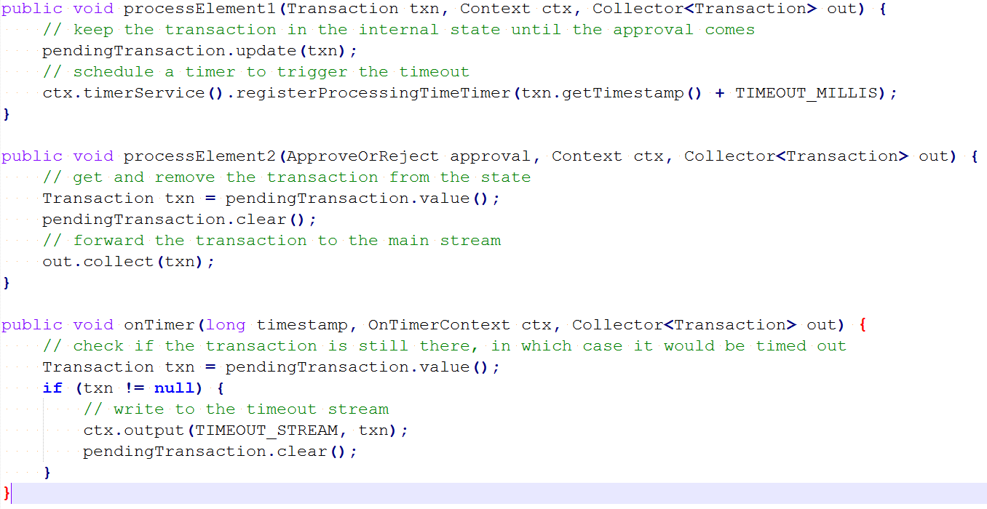
Low Level: Process Function

Slide 11
High Level: SQL (ANSI)
SELECT
campaign,
TUMBLE_START(clickTime, INTERVAL ’1’ HOUR),
COUNT(ip) AS clickCnt
FROM adClicks
WHERE clickTime > ‘2017-01-01’
GROUP BY campaign, TUMBLE(clickTime, INTERVAL ‘1’ HOUR)
Query
start of the stream
past
now
future

Slide 12
Flink in Practice
Athena X Streaming SQL Platform Service
Streaming Platform as a Service
100s jobs, 1000s nodes, TBs state
metrics, analytics, real time ML
Streaming SQL as a platform
Fraud detection
Streaming Analytics Platform

Slide 13
Parallel Stateful
Streaming Execution

Slide 14
Stateful Event & Stream Processing
Filter / Transform
State read/write
Source
Sink

Slide 15
Stateful Event & Stream Processing
Scalable embedded state
Access at memory speed &
scales with parallel operators

Slide 16
Stateful Event & Stream Processing
Rolling back computation
Re-processing
Re-load state
Reset positions
in input streams

Slide 17
Event Sourcing + Memory Image
periodically snapshot the memory
main memory
event / command
event log
update local
variables/structures
persists events
(temporarily)
Process

Slide 18
Event Sourcing + Memory Image
Recovery: Restore snapshot and replay events since snapshot
event log
persists events
(temporarily)
Process

Slide 19
Stateful Event & Stream Processing

Slide 20
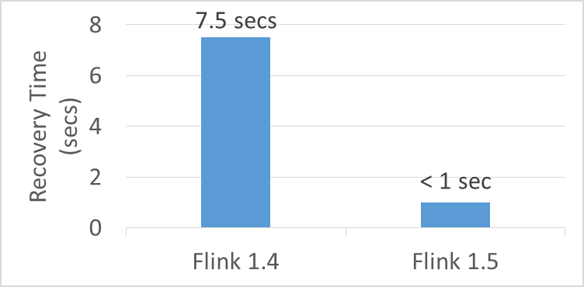
Localized State Recovery (Flink 1.5)
Piggybags on internal Multi-version data structures:
LSM Tree (RocksDB)
MV Hashtable (Fs / Mem State Backend)
Setup:
500 MB state per node
Checkpoints to S3
Soft failure (Flink fails, machine survives)

Slide 21
Having fun with snapshots

Slide 22
Creating periodic Snapshots
time

Slide 23
Replay from Savepoints to Drill Down
Incident of Interest
time
Extra sink for trace output
"Debug Job"
(modified version of original Job)
Filter (events of interest only)

Slide 24
Pause / Resume style execution
Bursty Event Stream
(events only at only end-of-day )
time

Slide 25
Pause / Resume style execution
Bursty Event Stream
(events only at only end-of-day )
time
Checkpoint / Savepoint Store

Slide 26
On the future of batch and stream processing…
(The world according to Flink)

Slide 27
A.k.a.: If everything is
peachy streams, why is there
a DataSet API and where
will this end?

Slide 28
A.k.a.: I have heard that "batch is a special case of streaming", so does <stream processor x> now own the world?

Slide 29
What changes faster? Data or Query?
Data changes slowly compared to fast
changing queries
Data changes fast application logic
is long-lived
ad-hoc queries, data exploration, ML training and (hyper) parameter tuning
continuous applications, data pipelines, standing queries,
anomaly detection, ML evaluation, …
Batch Processing Use Case
Stream Processing Use Case

Slide 30
What changes faster? Data or Query?
Data changes slowly compared to fast
changing queries
Data changes fast application logic
is long-lived
ad-hoc queries, data exploration, ML training and (hyper) parameter tuning
continuous applications, data pipelines, standing queries,
anomaly detection, ML evaluation, …
DataSet API
DataStream API
Batch Processing Use Case
Stream Processing Use Case

Slide 31
Abstraction/APIs and Runtime
Model, Semantics, APIs
Modelling Applications
Storage
Modelling Infrastructure
Execution Runtime
Running Applications

Slide 32
Samentics/APIs: Everything Streams
✔
we're good here…

Slide 33
What changes faster? Data or Query?
Data changes slowly compared to fast
changing queries
Data changes fast application logic
is long-lived
DataStream API BoundedStream
DataStream API UnboundedStream
ad-hoc queries, data exploration, ML training and (hyper) parameter tuning
continuous applications, data pipelines, standing queries,
anomaly detection, ML evaluation, …
DataSet API
DataStream API
Batch Processing Use Case
Stream Processing Use Case

Slide 34
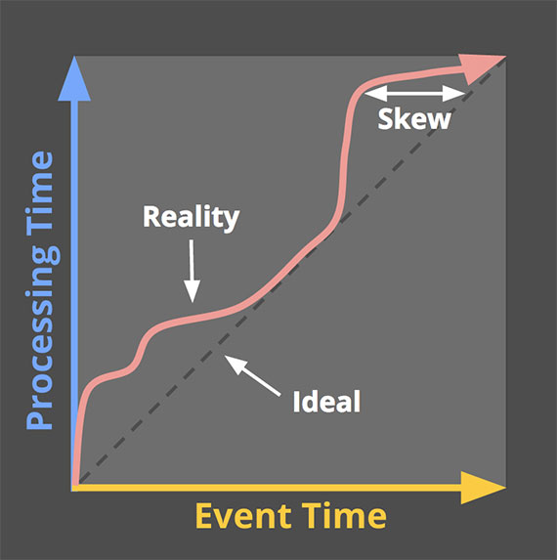
Latency vs. Completeness (in Tyler's words)

Slide 35
Latency vs. Completeness (in my words)
Event Time
Rogue One III.5
Episode IV
Episode V
Episode VI
Episode I
Episode II
Episode III
Episode VII
Episode VIII
1977
1980
1983
1999
2002
2005
2015
2016
2017
Processing Time

Slide 36
Latency versus Completeness
Bounded/ Batch
Unbounded/
Streaming
Data is as complete
as it gets within that Batch Job
Trade of latency versus completeness
No fine latency control

Slide 37
What changes faster? Data or Query?
DataStream API BoundedStream
No latency SLA
Assume Data Completeness
DataStream API UnboundedStream
Latency / Completeness Tradeoff
Data changes slowly compared to fast
changing queries
Data changes fast application logic
is long-lived
DataStream API BoundedStream
DataStream API UnboundedStream
ad-hoc queries, data exploration, ML training and (hyper) parameter tuning
continuous applications, data pipelines, standing queries,
anomaly detection, ML evaluation, …
DataSet API
✔
DataStream API
Batch Processing Use Case
Stream Processing Use Case

Slide 38
On the Runtime Side?
Streaming
Keep up with real time, some extra capacity for catch-up
Receive data roughly in order as produced
Latency is important
Batch
Fast forward through months/years of history
Massively parallel unordered reads
Throughput most important

Slide 39
Streaming Runtime
Time in data stream must be quasi monotonous, produce time progress (watermarks)
Always have close-to-latest incremental results
Resource needs change over time

Slide 40
Batch Runtime
Order of time in data does not matter (parallel unordered reads)
Bulk operations (2 phase hash/sort)
Longer time for recovery (no low latency SLA)
Resource requirements change fast throughout the execution of a single job

Slide 41
Ordered and unordered reads
read unordered
(massively parallel splits)
read ordered
(low parallelism, per partition)

Slide 42
What is Flink's take here?
Unique Network Stack, high throughput, low latency, memory speed
Unique Fault Tolerance Model that recovers batch and streaming with tunable cost / recovery-lag
Sources can read streams and parallel input splits
Different data Structures optimized for incremental results (DataStream API) and for batch results (DataSet API)
Most unified runtime, but more unification still needed…

Slide 43
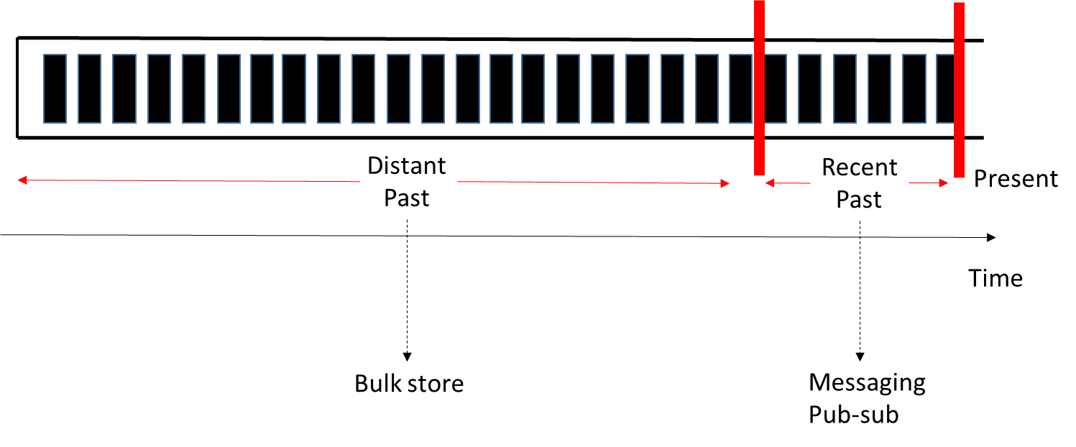
Streams and Storage
(✔)
getting there…
Pravega
HDFS, S3, GCS, SAN, NAS, NFS, ECS, Swift, Ceph, …
Kafka / PubSub / Kinesis / …

Slide 44
SQL Semantics: Streaming = Batch
SQL Query
input table
(regular / bounded) SQL Query
result table
Streaming SQL Query

Slide 45
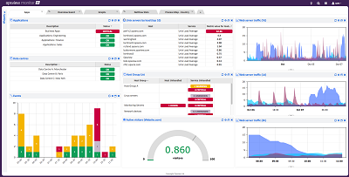
Streaming SQL and Batch SQL
Dashboard Many short queries BATCH
View Materialization
Standing Query
STREAMING
Appl.
stream
Streaming SQL Query
materialized real-time view
stream
CDC
continuous query
K/V Store or SQL Database
DB

Slide 46
Thank you!

Slide 47
15% Discount Code: QConFlink

Slide 48
Framework vs. Library
Long running application
under the control of your
container manager
Standing Processes / Endpoints,
Dynamic Control over Resources

