Slide 1
Deploying On-Prem as SaaS Why we go with Ansible
QCon London 2015
Martin Etmajer, Technology Strategist @ Dynatrace

Slide 2
Martin Etmajer Technology Strategist @Dynatrace
martin.etmajer@dynatrace.com
@metmajer
http://blog.dynatrace.com

Slide 3
Agenda
Dynatrace On-Prem
Dynatrace SaaS Architecture
Ansible as Orchestration Engine
Test-Driven Infrastructure with Test Kitchen

Slide 4
Dynatrace
Notes:
What a traditional integration of Dynatrace looks like ...

Slide 5
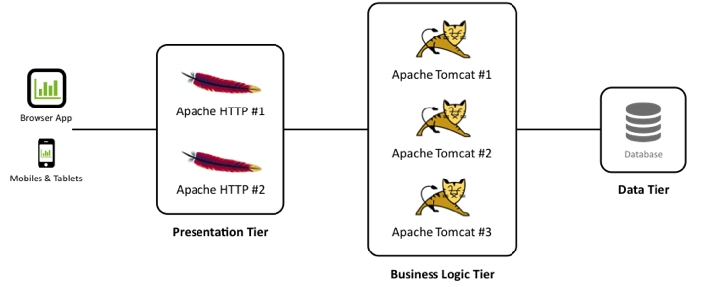
Dynatrace On-Prem Environment

Slide 6
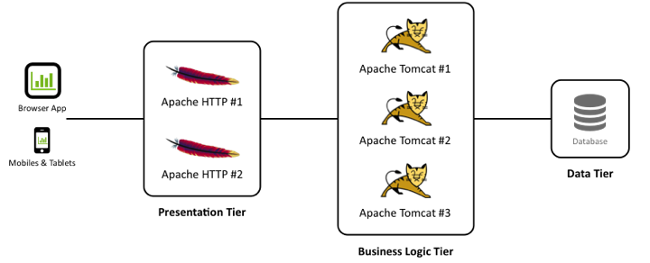
Dynatrace On-Prem Environment

Slide 7
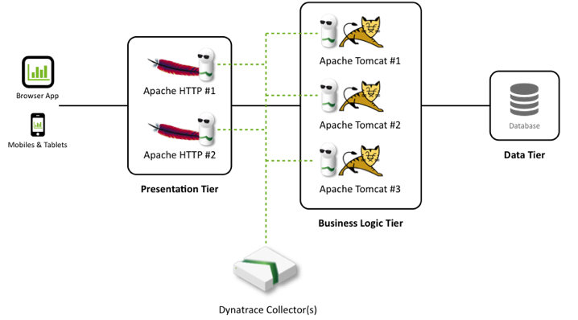
Dynatrace On-Prem Environment
Notes:
The Dynatrace Collector allows our Agents to be as light-weight as possible (the extra load induced by the agents into the application is reduced to an absolute minimum): agents relay metrics to the collector which secures and compresses data. This allows us to capture 100% of the transactions even in large scale applications.

Slide 8
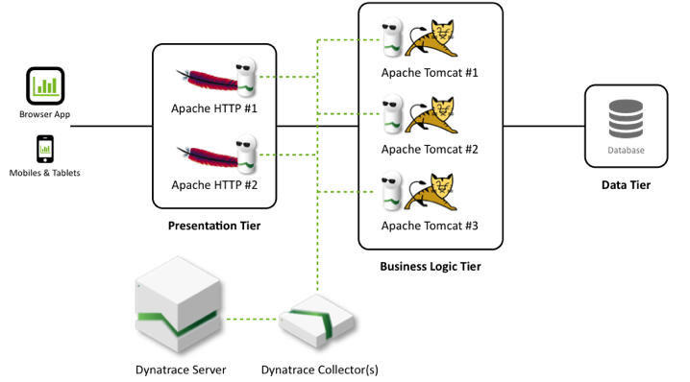
Dynatrace On-Prem Environment
Notes:
The Dynatrace Server receives data from its collectors and prepares the data for real-time analysis, charting and trending.

Slide 9
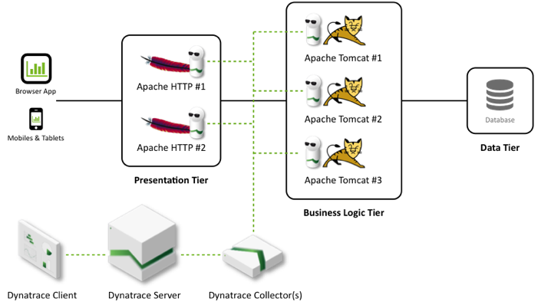
Dynatrace On-Prem Environment
Notes:
The Dynatrace Client is your window to Dynatrace data for creating dashboards and configuration.

Slide 10
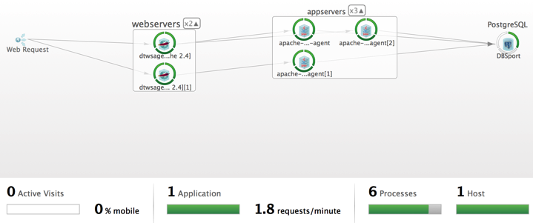
Dynatrace. So What?
Business Logic Tier
Presentation Tier

Slide 11
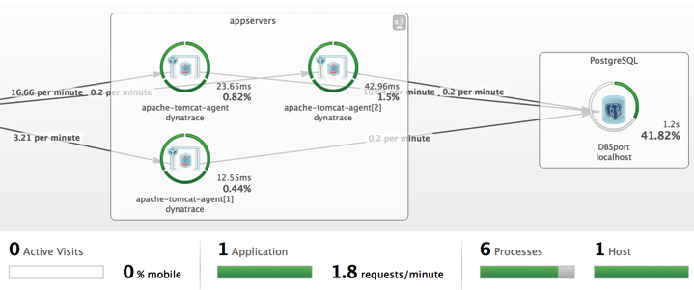
Dynatrace. So What?
Health
# Requests
Timings

Slide 12
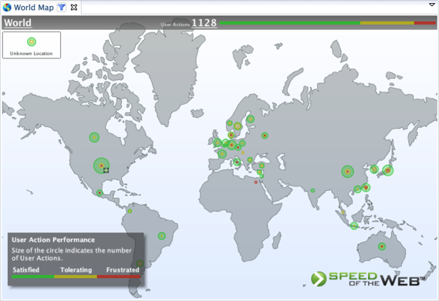
Dynatrace. So What?
Frustrated Users

Slide 13
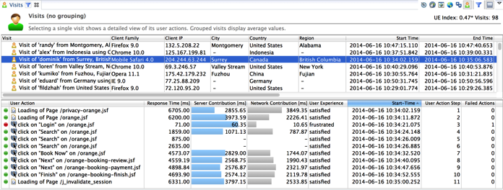
Dynatrace. So What?
What happened?

Slide 14
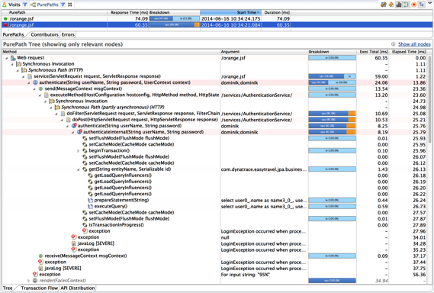
Dynatrace. So What?
Erroneous Call
Username
SQL Statements
Exception
Notes:
Dynatrace allows you to export and share these data in a static session file to facilitate collaboration between Development and Operations.

Slide 15
Reasons for Going SaaS

Slide 16
Reasons for Going SaaS
#1: Operational Risk
Moves from Customer to Service Provider

Slide 17
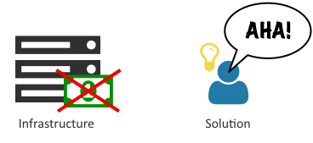
Reasons for Going SaaS
#2: Customers Want Solutions
Without Buying Extra Infrastructure

Slide 18
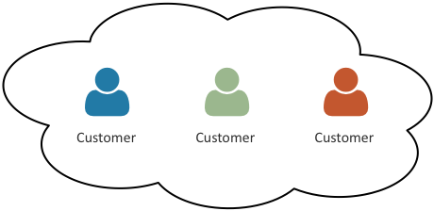
Reasons for Going SaaS
#3: Customers Already in the Cloud

Slide 19
Dynatrace SaaS Architecture

Slide 20
On-Prem Dynatrace Environment

Slide 21
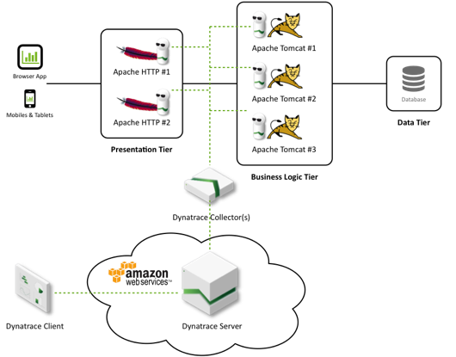
Dynatrace SaaS Environment

Slide 22
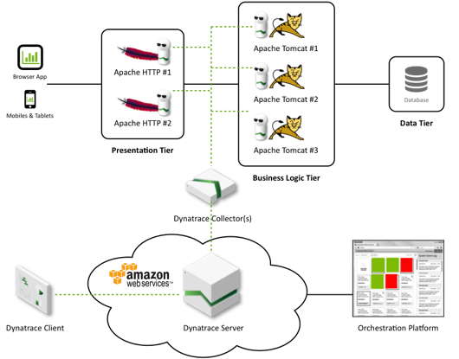
Dynatrace SaaS Environment

Slide 23
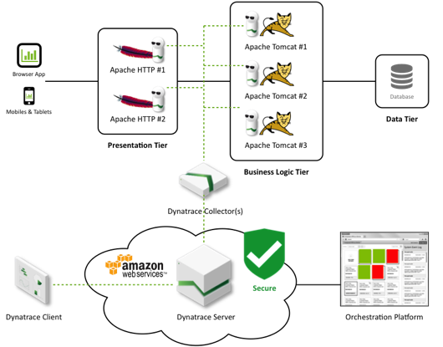
Dynatrace SaaS Environment

Slide 24
for Dynatrace SaaS
Elastic Compute Cloud (EC2)
Notes:
For maintaining customer instances with Dynatrace inside.

Slide 25
for Dynatrace SaaS
Elastic Block Store (EBS)
Notes:
For creating persistent volumes that we attach to EC2 instances.

Slide 26
for Dynatrace SaaS
Relational Database Service (RDS)
Notes:
“Database as a Service”: for storing Dynatrace time-series data.

Slide 27
for Dynatrace SaaS
Elastic IP (EIP)
Notes:
For attaching a static IP to an EC2 instance.

Slide 28
for Dynatrace SaaS
Route 53 (DNS)
Notes:
For attaching a domain name to an EC2 instance.

Slide 29
for Dynatrace SaaS
Simple Storage Service (S3)
Notes:
For storing configuration and backup data.

Slide 30
for Dynatrace SaaS
CloudWatch
Notes:
For Service Monitoring and Alerting.

Slide 31
Design Decisions

Slide 32
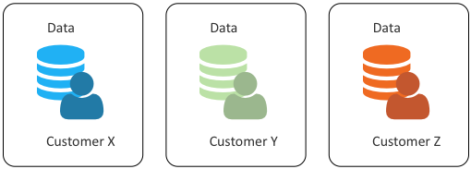
#1 – Dedicated Customer Resources
Clean Separation of Customers & Data

Slide 33
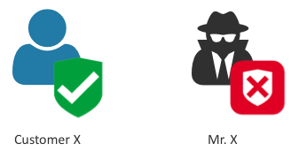
#1 – Dedicated Customer Resources
Customizable Security
IP-Based Access Rules

Slide 34
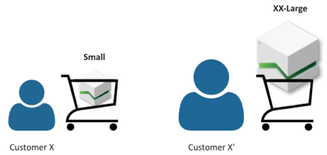
#1 – Dedicated Customer Resources
Grow with the Customer
Resize Resources on Demand

Slide 35
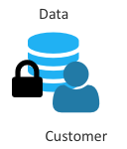
#2 – Data Persistence
Prevent Data Loss
When Resources Go Down

Slide 36
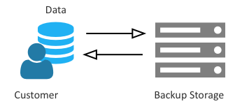
#3 – Regular Backups
Enable < Daily Data Recovery
All Configuration and Data

Slide 37
Orchestration Platform

Slide 38
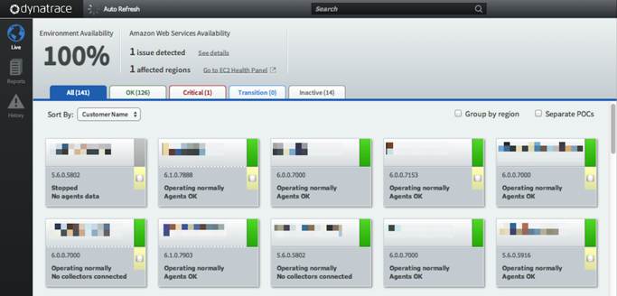
Orchestration Platform

Slide 39
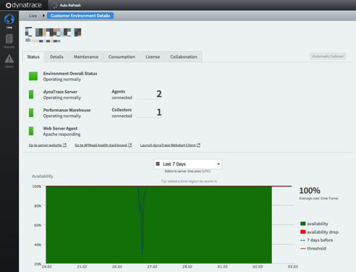
Orchestration Platform

Slide 40
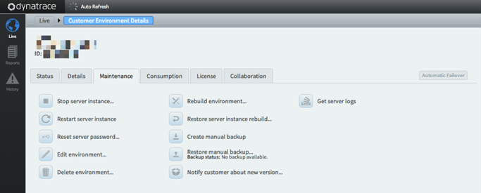
Orchestration Platform

Slide 41
How We Did It
Lessions Learned

Slide 42
We Coded Our Own Solution
#1: Lifecycle Management of Resources

Slide 43
We Coded Our Own Solution
#2: Use-Cases

Slide 44
We Coded Our Own Solution
#3: Monitoring

Slide 45
We Coded Our Own Solution
Extensive Testing
Too much Manual Work Involved
Large Codebase, Tied to Single Vendor

Slide 46
We Coded Our Own Solution
Notes:
Code refactoring

Slide 47
Hey, Ansible!

Slide 48
What is Ansible?
Ansible is a radically simple IT automation engine for
environment and infrastructure provisioning
configuration management
application deployment
etc.

Slide 49
Why Yet Another Tool?
“I wrote Ansible because none of the existing tools fit my brain. I wanted a tool that I could not use for 6 months, come back later, and still remember how it worked.”
Michael DeHaan, Ansible Founder
“We need to do a rolling deployment of changes that have certain dependencies (including external services). With Ansible this becomes trivial. Puppet on the other hand feels like the Wild West.”
User IUseRhetoric on reddit.com

Slide 50
Ansible Design Principles
No Agents ✓
No Scripting ✓
Simple and Powerful ✓
Notes:
Anyone from developer or sysadmin to IT management should be able to learn, use and understand it.
Low learning curve, create automation projects quickly
Extensive modules library
Clarity: anyone, whether developer, sysadmin or IT manager, should be learn, use and understand
Speed: low learning curve, create prototypes quickly
Power: extensive (and extensible) modules library as automation toolbox, no custom scripting - “batteries included”
Efficiency: agentless: no extra software (dependencies) to manage and maintain on managed hosts, lightweight; connects via SSH on Linux or WinRM + Powershell on Windows
Security: agentless: nothing leftover and no daemon processes running on managed hosts

Slide 51
Agent-Based Architecture

Slide 52
Agent-Based Architecture

Slide 53
Agent-Based Architecture

Slide 54
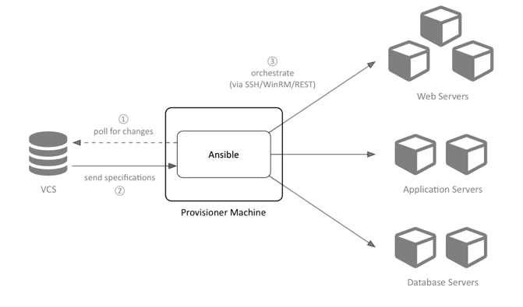
Ansible’s Agentless Architecture

Slide 55
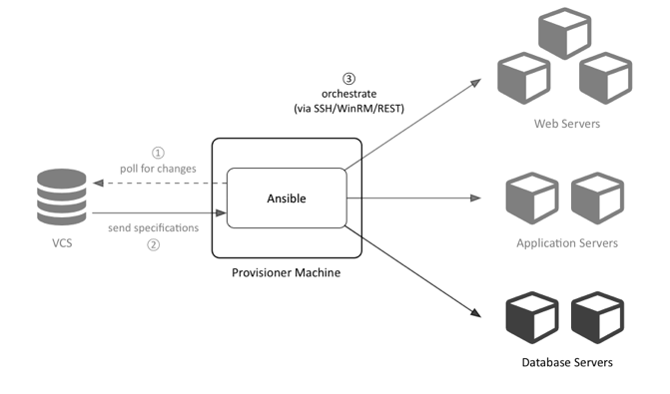
Ansible’s Agentless Architecture

Slide 56
Ansible’s Agentless Architecture

Slide 57
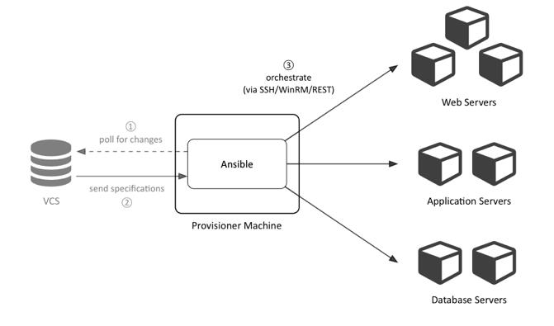
Ansible’s Agentless Architecture

Slide 58
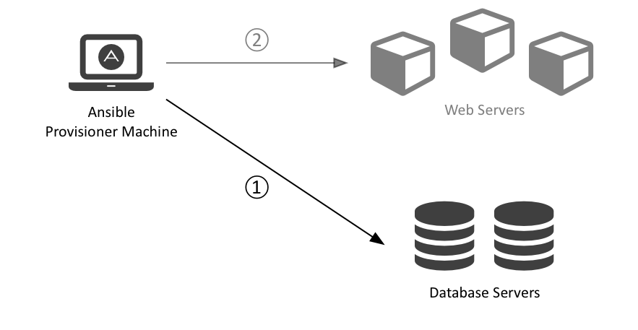
Ansible is an Orchestration Engine. So What?
Notes:
Manage complex multi-tier deployments in a controlled fashion:
Deploy the database before deploying web servers and enabling new web server code
Configure the database with the web servers IP addresses so they can connect to it
Add the web servers to a load balancing pool
Add the servers to a pool of monitored hosts

Slide 59
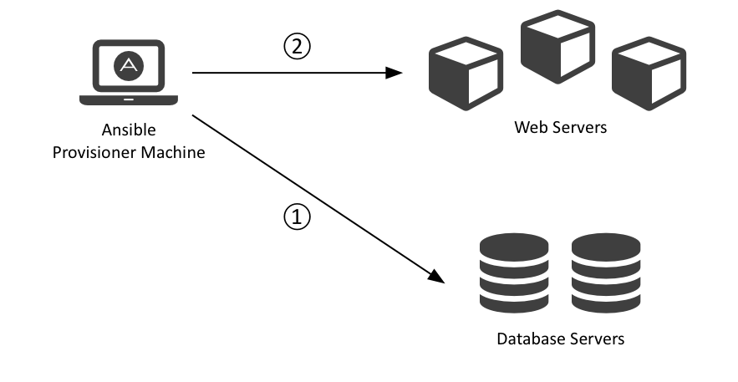
Ansible is an Orchestration Engine. So What?
Notes:
Manage complex multi-tier deployments in a controlled fashion:
Deploy the database before deploying web servers and enabling new web server code
Configure the database with the web servers IP addresses so they can connect to it
Add the web servers to a load balancing pool
Add the servers to a pool of monitored hosts

Slide 60
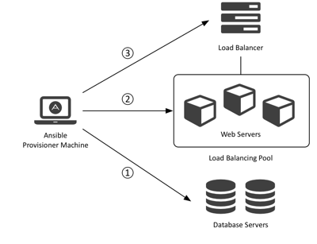
Ansible is an Orchestration Engine. So What?
Notes:
Manage complex multi-tier deployments in a controlled fashion:
Deploy the database before deploying web servers and enabling new web server code
Configure the database with the web servers IP addresses so they can connect to it
Add the web servers to a load balancing pool
Add the servers to a pool of monitored hosts

Slide 61
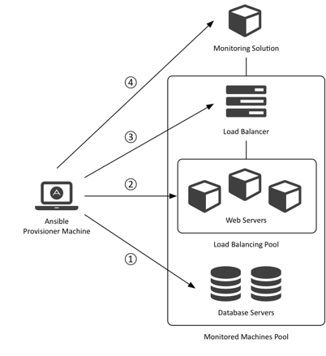
Ansible is an Orchestration Engine. So What?
Notes:
Manage complex multi-tier deployments in a controlled fashion:
Deploy the database before deploying web servers and enabling new web server code
Configure the database with the web servers IP addresses so they can connect to it
Add the web servers to a load balancing pool
Add the servers to a pool of monitored hosts

Slide 62
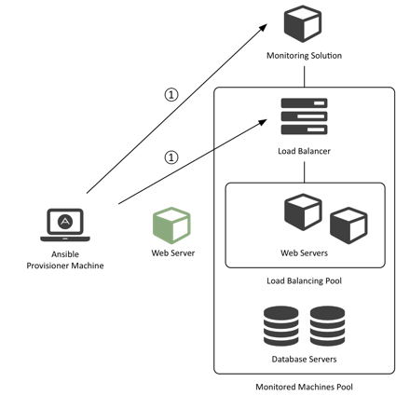
Ansible is an Orchestration Engine. So What?
Notes:
Suppose that later on we want to update our web servers:
Take a web server node out of monitoring and load balancing pools
Update the web server code, adapt the database schema and run smoke tests
Reintegrate

Slide 63
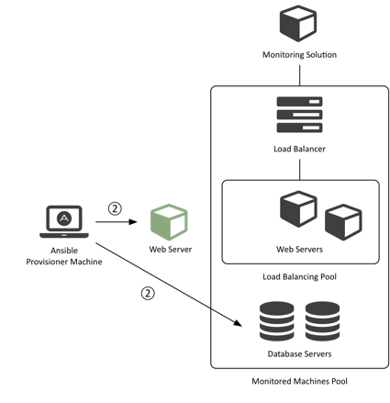
Ansible is an Orchestration Engine. So What?
Notes:
Suppose that later on we want to update our web servers:
Take a web server node out of monitoring and load balancing pools
Update the web server code, adapt the database schema and run smoke tests
Reintegrate

Slide 64
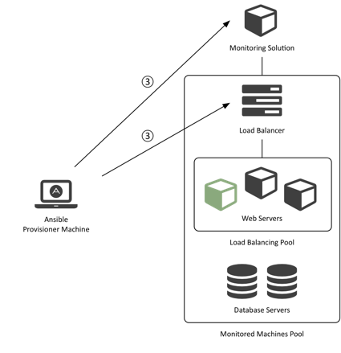
Ansible is an Orchestration Engine. So What?
Notes:
Suppose that later on we want to update our web servers:
Take a web server node out of monitoring and load balancing pools
Update the web server code, adapt the database schema and run smoke tests
Reintegrate

Slide 65
Ansible for the Cloud

Slide 66
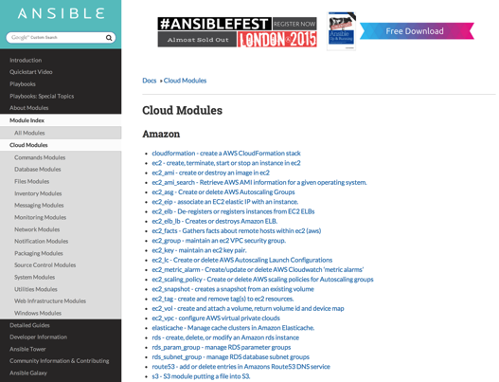
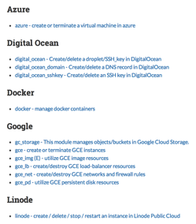
Ansible Cloud Modules
Notes:
Ansible Cloud Modules for Amazon include modules to manage: instances in the EC2, AMIs, Auto Scaling Groups (ASGs), Elastic Ips (EIPs), Elastic Load Balancers (ELBs), Key Pairs, Security Groups, Elastic Block Storage (EBS) Volumes, Route53, RDS, etc.

Slide 67
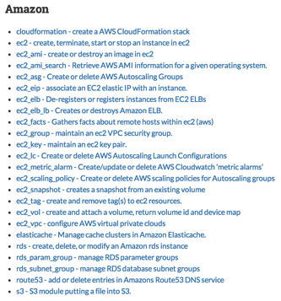
Ansible Cloud Modules
Notes:
Ansible Cloud Modules for Amazon include modules to manage: instances in the EC2, AMIs, Auto Scaling Groups (ASGs), Elastic Ips (EIPs), Elastic Load Balancers (ELBs), Key Pairs, Security Groups, Elastic Block Storage (EBS) Volumes, Route53, RDS, etc.

Slide 68
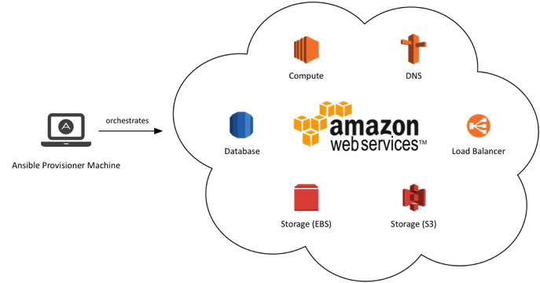
Ansible Cloud Modules for Amazon

Slide 69
Ansible Concepts: Inventories

Slide 70
Ansible Inventories
Ansible provisions groups of servers at once
Groups and hosts are defined in inventories
Use inventories for staging, production, etc.
Static vs. Dynamic Inventories
Static: text files expressed in an INI-like format
Dynamic: Python scripts for dynamic environments (cloud)
Static + Dynamic: combine multiple inventories (hybrid cloud)

Slide 71
Example: Static Inventory
 | # file: production [balancers] www.example.com [webservers] www[0-9].example.com [dbservers] db[a:f].example.com [monitoring] dynatrace.example.com
Group
Host
Numeric Range
Alphabetic Range

Slide 72
Dynamic Inventories
Python scripts that get data from dynamic sources such as:
Cloud: Amazon, DigitalOcean, Google, OpenShift, OpenStack, etc.
Distributed Information Services: LDAP, etcd, etc.

Slide 73
Ansible Concepts: Playbooks

Slide 74
Ansible Playbooks
$> ansible-playbook [–i <inventory>] <playbook.yml>
What is a Playbook?
Describes policies your managed machines shall enforce
Consist of vars, tasks, handlers, files, templates and roles
Expressed in the YAML format (dictionaries, lists and scalars)

Slide 75
Example: Ansible Playbook
--- # file: webservers.yml - hosts: webservers handlers: - name: reload apache2 service: name=apache2 state=reloaded tasks: - name: Install Apache HTTP Server apt: name=apache2 update_cache=yes - name: Install Apache Modules apache2_module: name={{ item }} state=present with_items: - proxy - proxy_httpd notify: reload apache2 remote_user: deploy sudo: yes
Play
Module
Arguments
Variable
Notify Handler

Slide 76
Example: Ansible Playbook
--- # file: playbook.yml include: balancers.yml include: webservers.yml include: dbservers.yml include: monitoring.yml

Slide 77
Example: Ansible Playbook
$> ansible-playbook –i production webservers.yml PLAY [webservers] ******************************************************* TASK: [Install Apache HTTP Server] ******************************************************* changed: [www0.example.com] changed: [www1.example.com] ... PLAY RECAP ******************************************************* web0.example.com: ok=3 changed=3 unreachable=0 failed=0 web1.example.com: ok=3 changed=3 unreachable=0 failed=0 ...

Slide 78
Ansible Concepts: Roles

Slide 79
Ansible Roles
Are the best way to organize a playbook!
Structure content into related vars, tasks, files, handlers, etc.
File structure for automated inclusion of role-specific content
Roles can be shared and pulled from Ansible Galaxy, GitHub, etc.

Slide 80
Ansible Roles: File Structure
ansible.cfg
production
staging
webservers.yml
roles/
common/
defaults/
files/
handlers/
meta/
tasks/
templates/
vars/
apache2/
...

Slide 81
Example: Ansible Playbook
--- # file: webservers.yml - hosts: webservers roles: - { role: common } - { role: apache2 } remote_user: deploy sudo: yes

Slide 82
Ansible: Our Use-Cases

Slide 83
Use-Case #1
Create Dynatrace AMI

Slide 84
#1 – Create Dynatrace AMI
#1: Remove Existing Dynatrace AMI

Slide 85
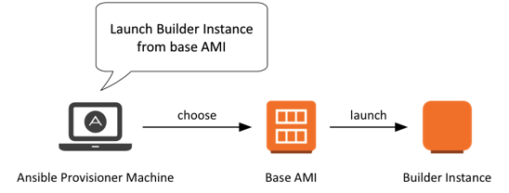
#1 – Create Dynatrace AMI
#2: Launch Builder Instance

Slide 86
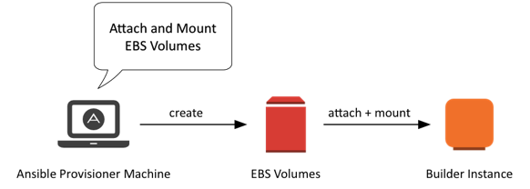
#1 – Create Dynatrace AMI
#3: Add Persistent Volumes

Slide 87
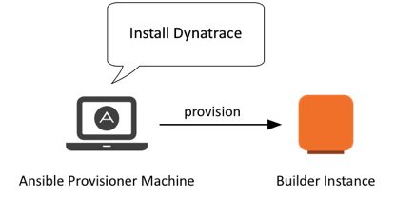
#1 – Create Dynatrace AMI
#4: Install Dynatrace

Slide 88
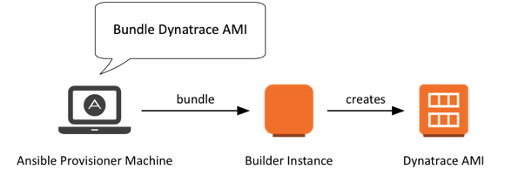
#1 – Create Dynatrace AMI
#5: Bundle Dynatrace AMI

Slide 89
#1 – Create Dynatrace AMI
#6: Register Dynatrace AMI

Slide 90
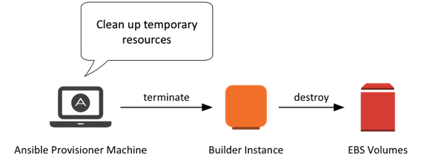
#1 – Create Dynatrace AMI
#7: Clean Up Temporary Resources

Slide 91
Use-Case #2
Create Dynatrace Instance

Slide 92
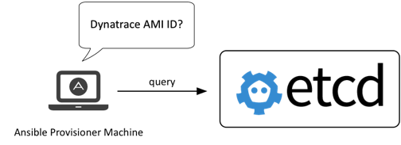
#2 – Launch Dynatrace Instance
#1: Get Dynatrace AMI ID

Slide 93
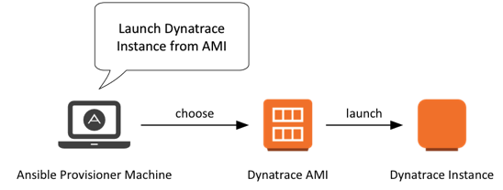
#2 – Launch Dynatrace Instance
#2: Launch Dynatrace Instance

Slide 94
#2 – Launch Dynatrace Instance
#3: Associate Static IP

Slide 95
#2 – Launch Dynatrace Instance
#4: Associate Domain Name

Slide 96
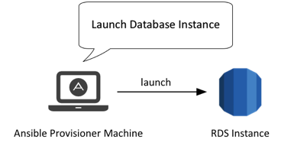
#2 – Launch Dynatrace Instance
#5: Launch Database Instance

Slide 97
Use-Case #3
Deploy Dynatrace Agents

Slide 98
Dynatrace On-Prem Environment

Slide 99
Test-Driven Infrastructure with Test Kitchen
Because your Infrastructure deserves tests, too!

Slide 100
What is Test Kitchen?
Test Kitchen allows you to test your infrastructure as code
on multiple platforms in isolation
supporting a wide range of drivers
with support for various provisioners
by using a variety of testing frameworks
in a pluggable architecture
CentOS, Debian, Fedora, etc.
Vagrant, Docker, EC2, etc.
Ansible, Chef, Puppet
bash, Cucumber, Serverspec, etc.
extend as desired!

Slide 101
Test Kitchen: Configure
 | --- # file: .kitchen.yml provisioner: name: ansible_playbook require_ansible_repo: true driver: name: vagrant customize: cpus: 2 memory: 2048 cpuexecutioncap: 50 platforms: # Opscode vagrant boxes: http://www.vagrantbox.es/ - name: centos-6.5 - name: ubuntu-12.04 suites: - name: dynatrace-agents - name: dynatrace-server
your test suites here!

Slide 102
Test Kitchen: Ansible Playbook
 | # file: test/integration/dynatrace-server/default.yml --- - hosts: all roles: - role: Dynatrace-Server foo: bar remote_user: vagrant
define a particular role under test

Slide 103
Test Kitchen: Serverspec
 | # file: test/integration/dynatrace-server/serverspec/spec.rb require 'serverspec’ ... describe user('dynatrace') do it { should exist } it { should belong_to_group 'dynatrace' } end describe service('dynaTraceServer') do it { should be_enabled } it { should be_running } end describe port(2021) do it { should be_listening } end
declare your assumptions

Slide 104
Test Kitchen: List Instances
 | $> kitchen list Instance Driver Provisioner dynatrace-agents-centos-65 Vagrant AnsiblePlaybook dynatrace-agents-ubuntu-1204 Vagrant AnsiblePlaybook dynatrace-server-centos-65 Vagrant AnsiblePlaybook dynatrace-server-ubuntu-1204 Vagrant AnsiblePlaybook ...
let’s test dynatrace-server* !

Slide 105
Test Kitchen: Test Instances
 | $> kitchen test dynatrace-server -----> Starting Kitchen (v1.3.1) -----> Cleaning up any prior instances of <dynatrace-server-centos-65> ... -----> Creating <dynatrace-server-centos-65>... Bringing machine 'default' up with 'virtualbox' provider... ... Finished in 0.6908 seconds (files took 0.74047 seconds to load) 24 examples, 0 failures -----> Starting Kitchen (v1.3.1) -----> Cleaning up any prior instances of <dynatrace-server-ubuntu-1204> ... -----> Creating <dynatrace-server-ubuntu-1204>... Bringing machine 'default' up with 'virtualbox' provider... ... Finished in 0.6947 seconds (files took 0.82016 seconds to load) 24 examples, 0 failures

Slide 106
Questions?

