Slide 1
From Rocks to Rust: Our C to Rust Paradigm Shift
Esther Momcilovic
Notes:
Before Metaswitch rescued me from a lonely and unlucrative life in academia, I studied the history of geology. And I’m here to draw parallels between a particular period of history that I studied, and what’s happening at Metaswitch today. About to talk about geology a lot – it is relevant!

Slide 2
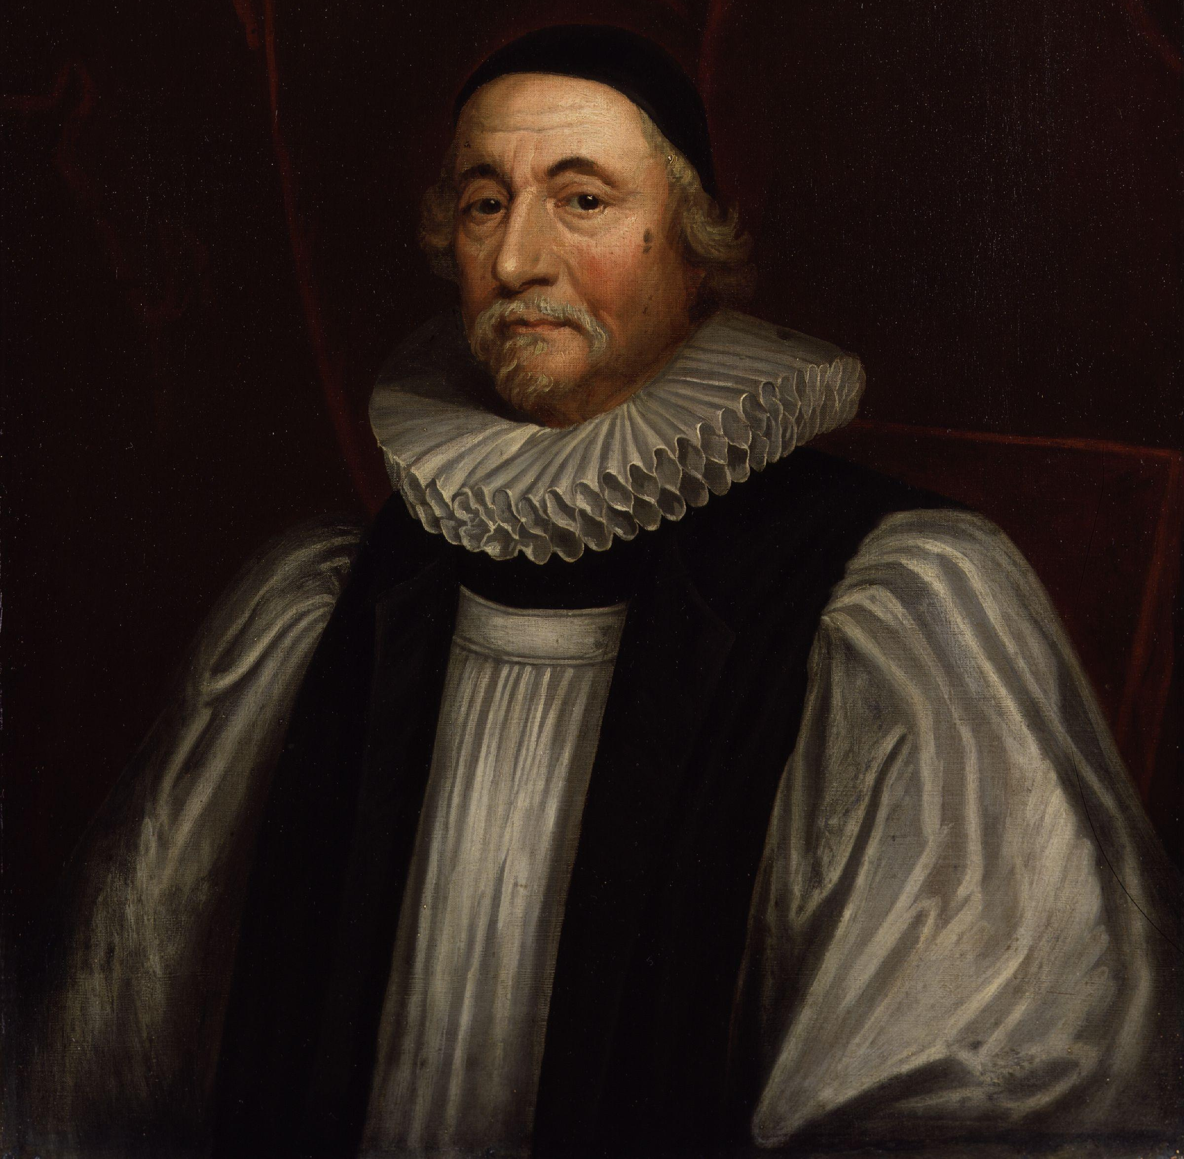
James Ussher (1581-1656)
22nd October 4004BC
…6PM
Notes:
6000 years old. Ages in Bible. Older? Shot down

Slide 3
Hutton’s Unconformity
“No vestige of a beginning, and no prospect of an end”
Siccar Point, Berwickshire
Notes:
1788, James Hutton. Unconformity. Deep time. Paradigm shift. What’s that got to do with anything?

Slide 4
Is Rust a paradigm shift?
Notes:
PhD History of Science.

Slide 5
If you’re writing software, sooner or later you’re going to write a bug
Notes:
Inevitable. New starters write lots. Some caught. Some sneaky. Emphasise you particularly mean memory bugs, like scribblers and memory leaks

Slide 6
Superhuman effort and supernatural forces

Slide 7
@metaswitch
Notes:
Deep time. New way of thinking. Adopting Rust same.

Slide 8
Why we chose Rust
Experiences from ‘the coal face’
Was it the right choice?
Notes:
“I was curious” – it wasn’t me who made this decision, but I spoke to the people who did.

Slide 9
Notes:
Over 30 years of experience in software engineering for telecoms. Used to be called Data Connection. Implementing function that is
Complex
Efficient – need high throughput given CPU and memory used (want to keep amount of hardware customer has to purchase and operate as low as possible)
Low-latency – for many applications <10ms between receiving a request and replying/forwarding
Reliable – 5 9s availability (including planned maintenance)

Slide 10
The history of the company made looking for a new language an interesting challenge
@metaswitch
Notes:
All products where performance is critical were written in C/C++ - fast, lightweight, no bloat, but it’s easy to write bugs with these, showing their age. Where we wrote in Java, had bad experiences with performance due to garbage collector – unacceptable variation in latency
Lots of languages. A lot of existing code and infrastructure. Integration. Moving to microservices, cloud native communications. Better efficiency across organisation. Optimise all experiences.

Slide 11
Adaptability to our customers’ needs
@metaswitch
Notes:
We’re a vendor, not an enterprise. So it’s not our own deployment, and we’re not the ones running it. Flexibility key. Supporting Client’s Ops team, not just our own

Slide 12
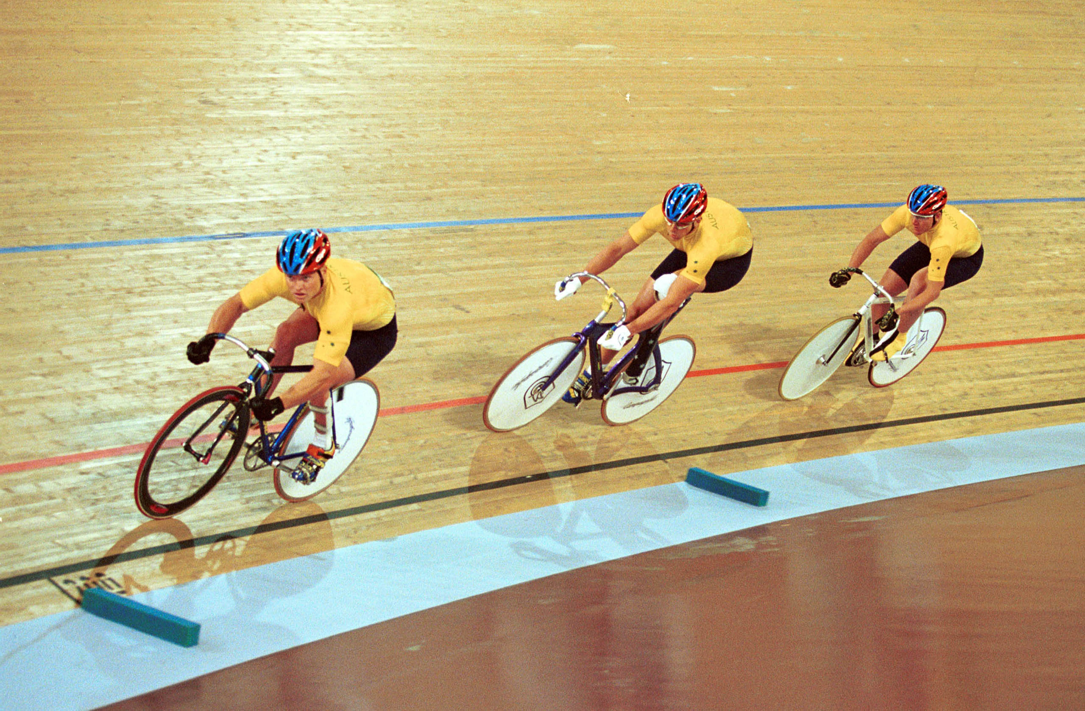
Real-time processing requirements mean a highly performant language is crucial
Notes:
Voice, video, telecoms. Requirements on genuine real-time processing. We need high-performance and – crucially – low latency. It has to be fast all the time, with no pauses. Run-time garbage collection is a non-starter.

Slide 13
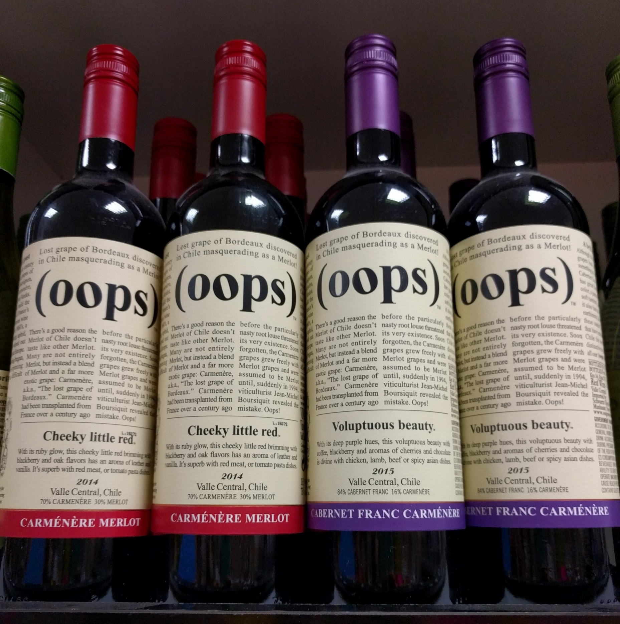
Make it harder to write bugs
Notes:
Not just for developer. Easier for those who support our products in field.

Slide 14
A broad, active community
Notes:
Engaged with language. Good tooling. Good set of libraries.

Slide 15
FUN!
Notes:
Hire brightest. Want to attract and retain those people. Enjoy it. Creative, efficient, not a slog.

Slide 16
Go vs Rust

Slide 17
Safe
Fast
Concurrent

Slide 18
Safe
@metaswitch
Notes:
Safe multi-threading. Can’t forget to free memory, check return code, etc. Ownership. Only one mutable reference. Lifetimes. Paradigm shift. No segmentation faults really appealed to our Support team!

Slide 19
Good tooling
@metaswitch
Notes:
Rust has all the tools you’d expect of a good modern programming language (standard UT framework, formatter, linter) – ease of use. Designed from ground up to have the most useful tooling. And Cargo, dependency manager is a huge plus – “one of the best dependency management tools I’ve used”

Slide 20
Highly performant
@metaswitch
Notes:
Competitive with idiomatic C and C++ in number of benchmarks. No garbage collector
Can write program using high-level concepts, but these are stripped away by compiler so that the code that is executed is simple and, more importantly, fast

Slide 21
Easy integration
@metaswitch
Notes:
No runtime required. Good FFI

Slide 22
Concerns
Steeper initial learning curve
The more immature of the two languages – a riskier choice
Notes:
Worried about this – return to later. More immature – was riskier choice at the time, less of a concern as things progressed

Slide 23
Notes:
I’m not wanting to bash Go here! Emphasise that it’s genuinely a case of Rust being a better fit for our needs – it has the edge for the business that we’re in

Slide 24
Notes:
No garbage collector = big plus. We have historically had lots of pain with the garbage collector. And remember, we’re running on a platform not under our control, so can’t just throw more resource at it

Slide 25
High performance and low latency
Fewer difficult-to-debug bugs in the field
Notes:
Allows us to play to our strengths

Slide 26
Why we chose Rust
Experiences from ‘the coal face’
Was it the right choice?

Slide 27
What it’s like to learn and code with
What its community is like
The day-to-day impact on project work
Notes:
Typical newbie

Slide 28
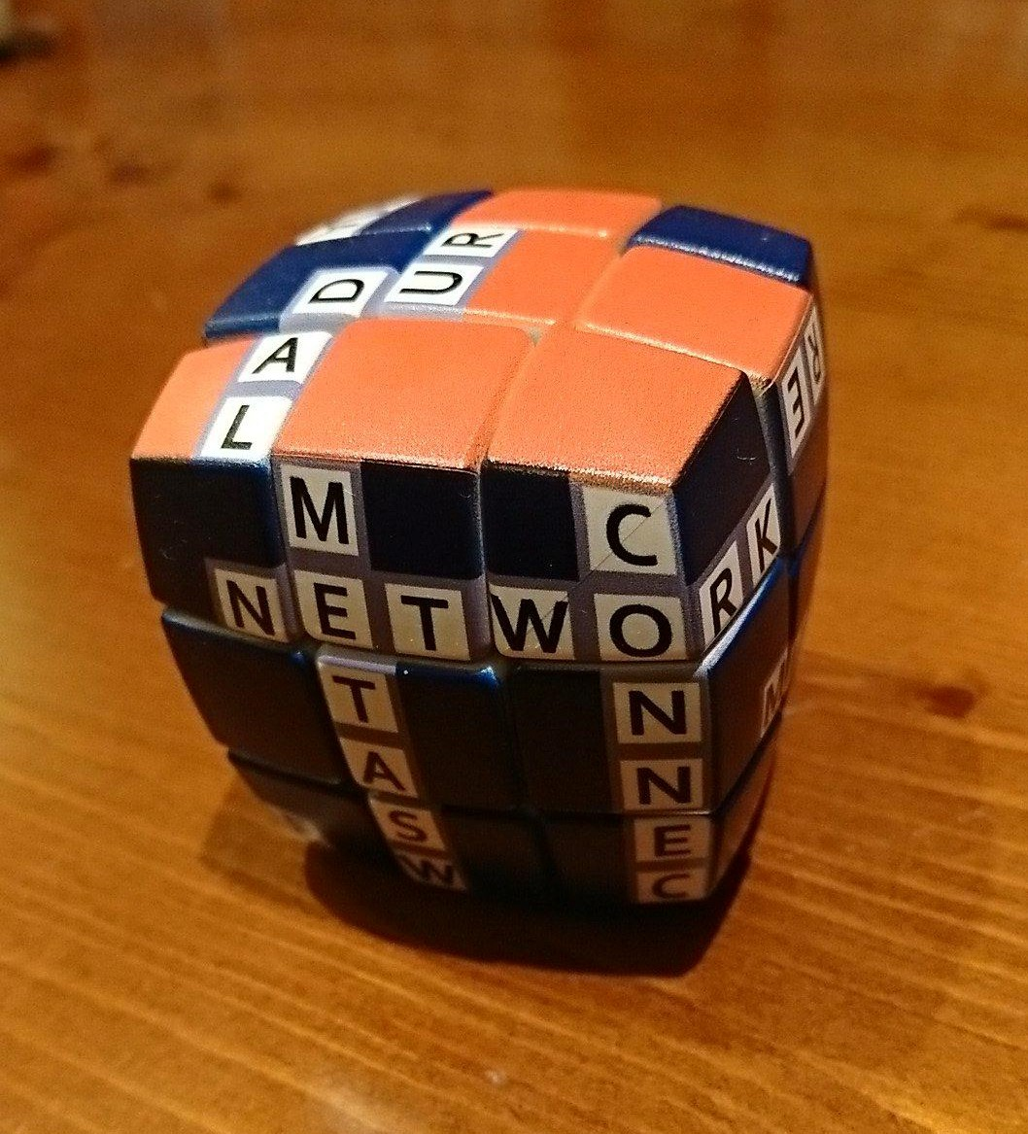
Problem solvers
Communicators
Passion for learning
No prior coding experience required
Notes:
Notably don’t select on prior experience

Slide 29
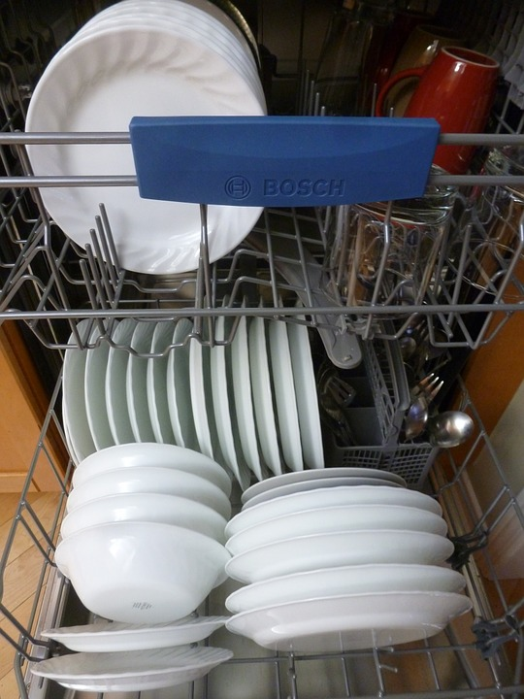
Notes:
Stack overflow. Command line.

Slide 30
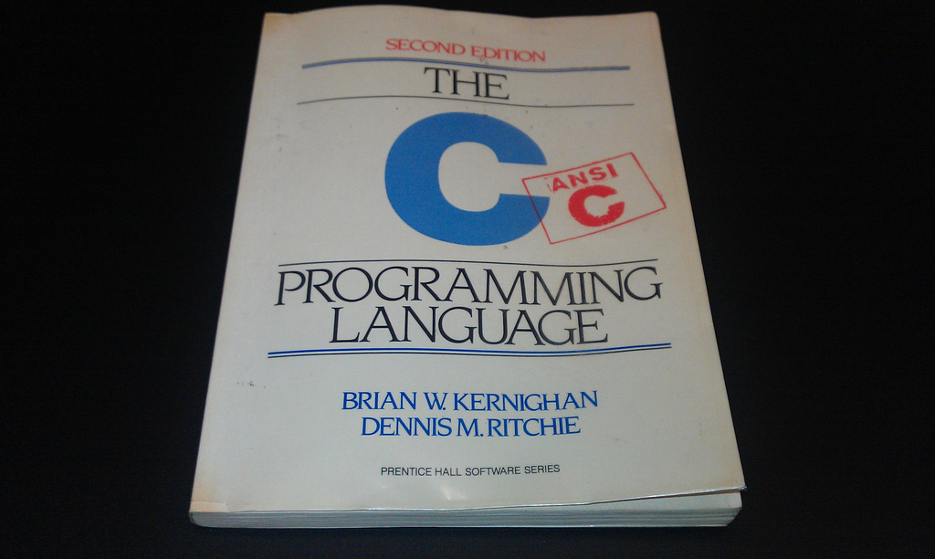
Notes:
Need a good textbook. Every bug in C has already been written. Way info presented crucial

Slide 31
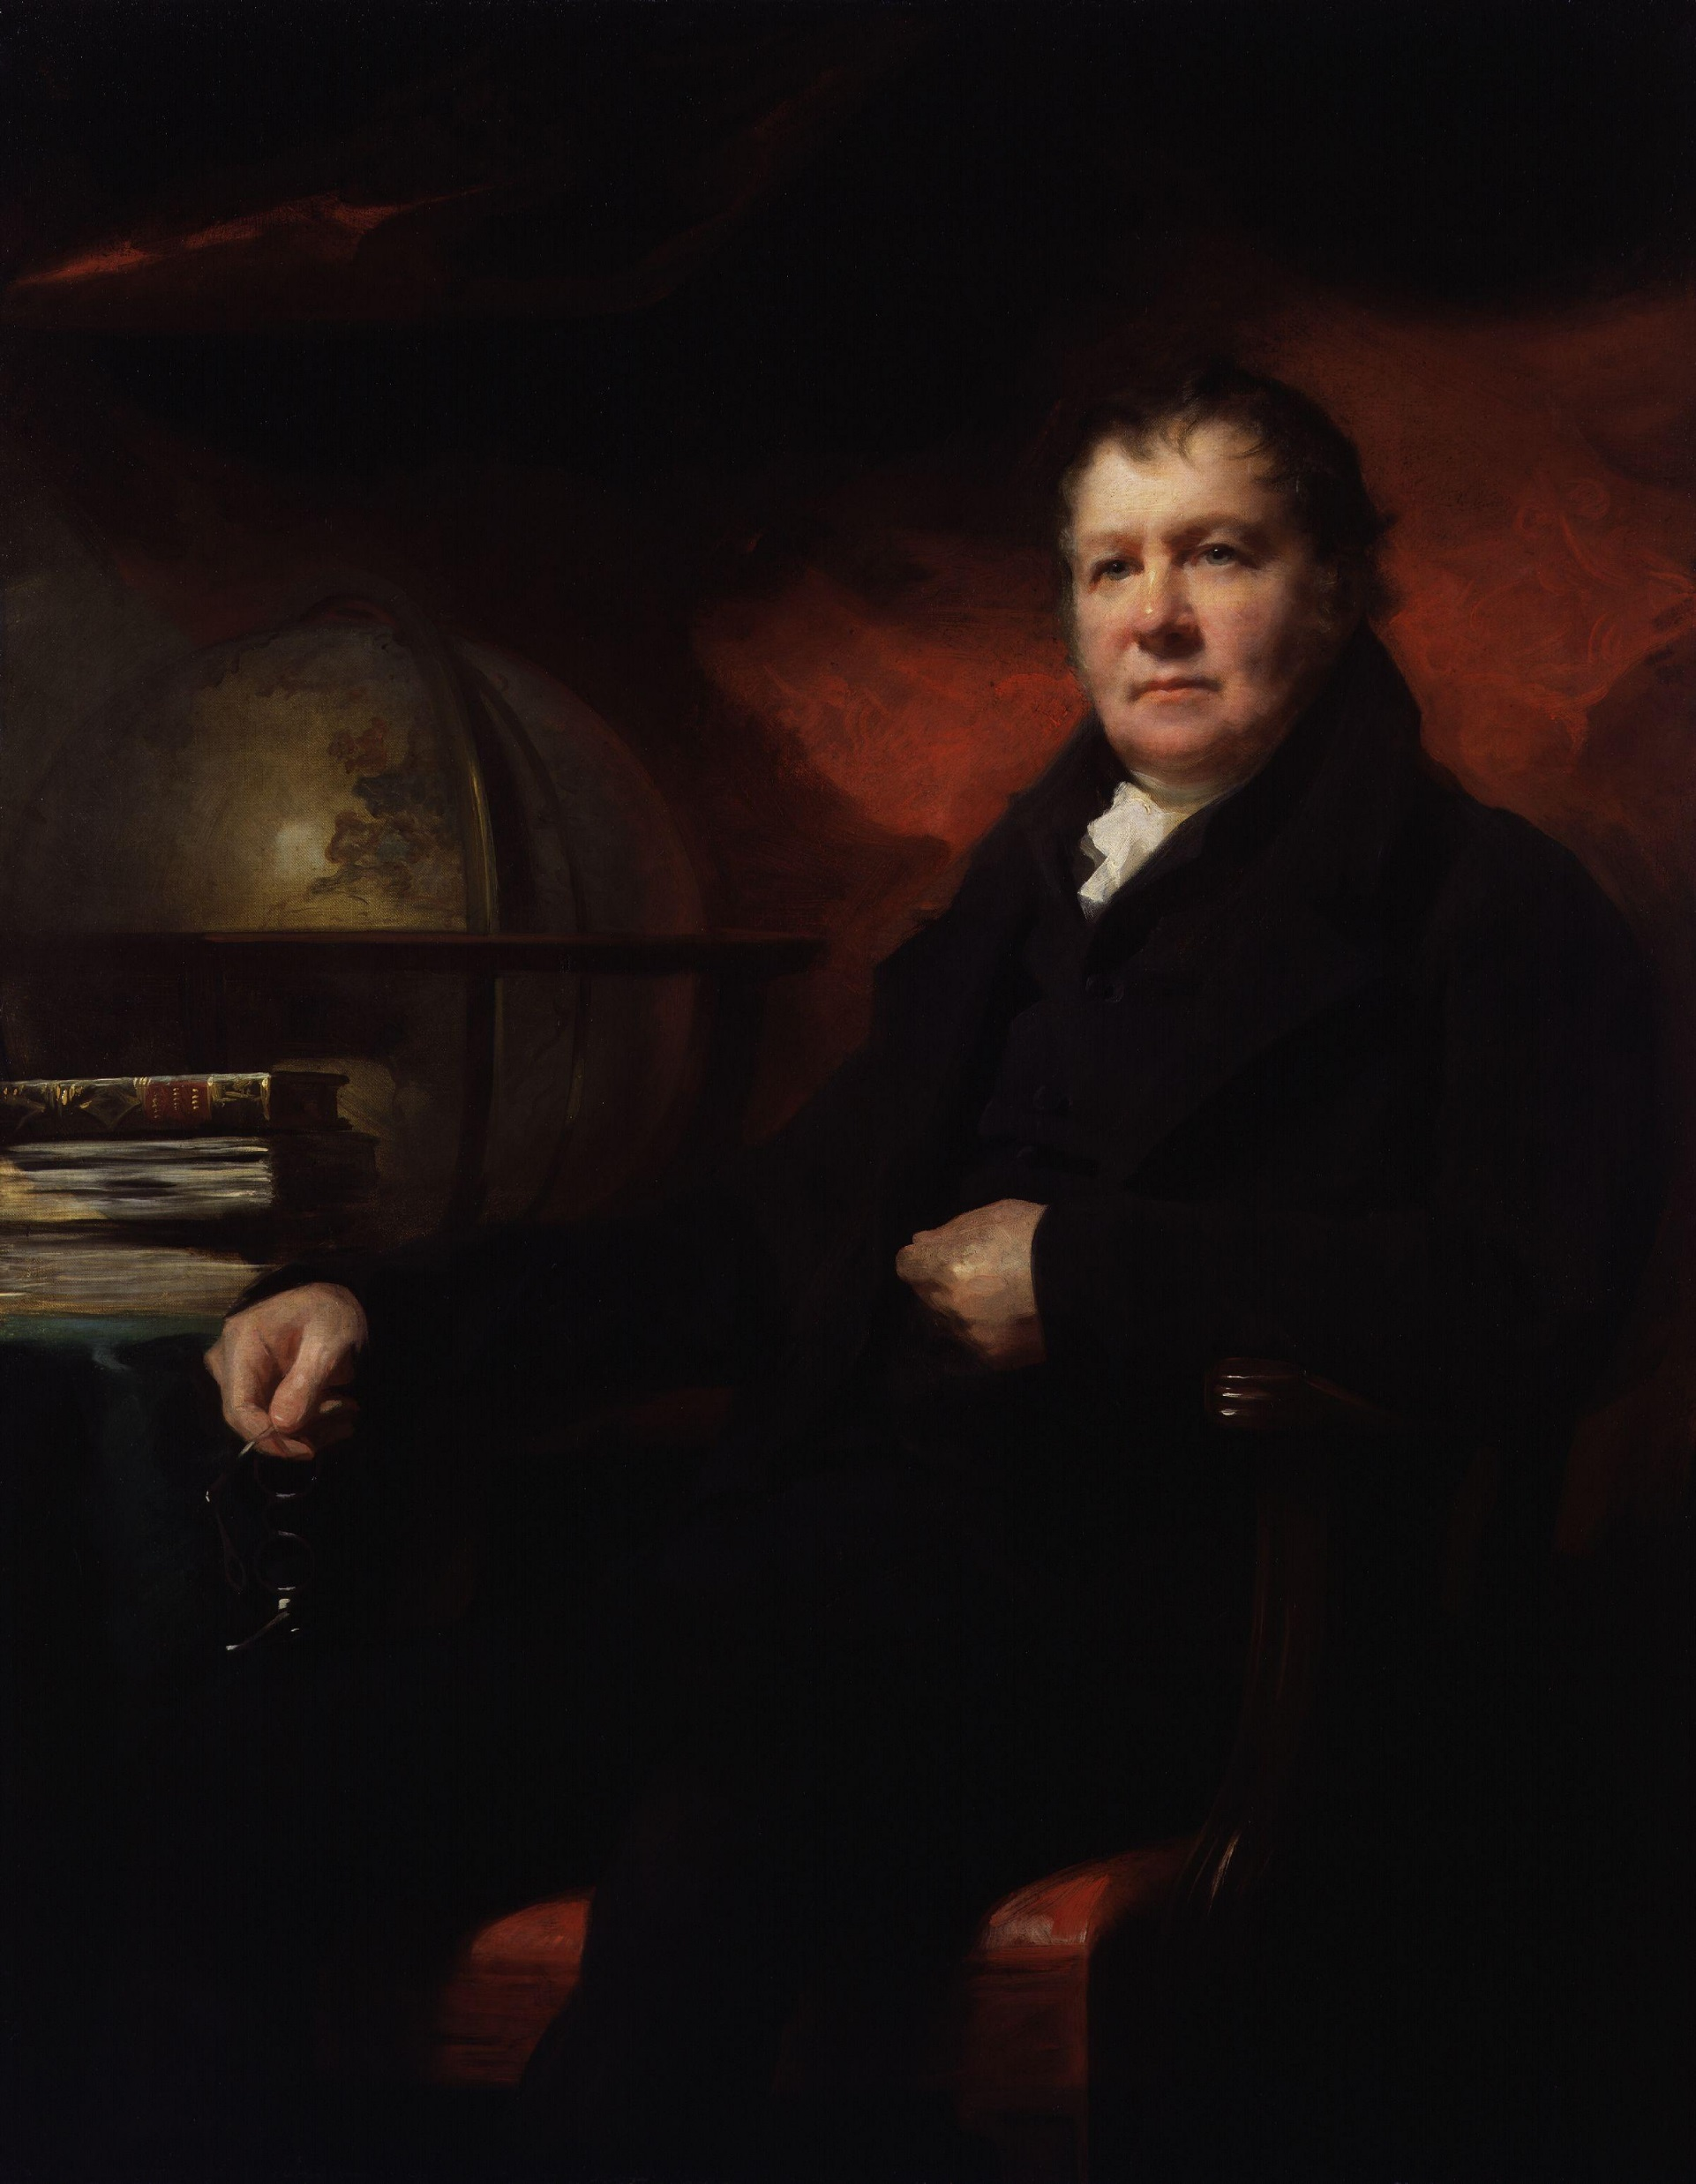
A good idea is nothing if it is not communicated well
Notes:
John Playfair, 1802 Illustrations of the Huttonian theory of the earth

Slide 32
And the Rust community cares about accessibility
Early adopters have made a path
Notes:
Curate best learning material. E.g. futures, examples of good design patterns. Rust community also responded. Focus on accessibility. Intern. Once you’ve learnt it, what’s it like?

Slide 33
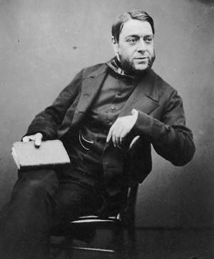
“…one enormous and superfluous lie for all mankind”
- Charles Kingsley, on Omphalos
Phillip Henry Gosse
@metaswitch
Notes:
Omphalos (navel), tree rings. Making the evidence fit the theory – wrong way round

Slide 34
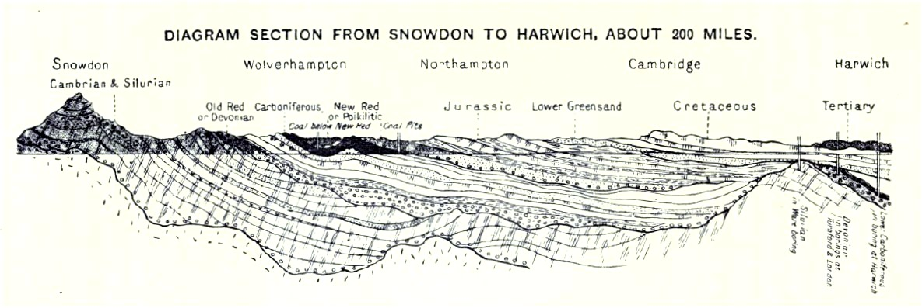
A new way of thinking
Notes:
Theory to fit the evidence. Safe is now new normal – explicitly make things unsafe rather than constantly worrying whether they are or not. Rather than thinking about how to make your code safe, you can concentrate on the business logic

Slide 35
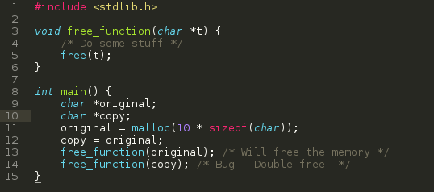
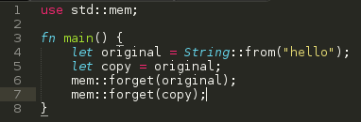
Notes:
This is gloriously over-simplified! But look – you can’t double free in Rust the way you can in C. No undefined behaviour in Rust. Not having to worry about nasty memory bugs also frees up the reviewer a bit more.

Slide 36
What it’s like to learn and code with
What its community is like
The day-to-day impact on project work

Slide 37
A responsive community
Notes:
Dedication to shallower learning curve. Kind and supportive, not brash (SO). Dependency issues resolved quickly. Listens to users – 2018 roadmap error messages, compiler speed

Slide 38
What it’s like to learn and code with
What its community is like
The day-to-day impact on project work
Notes:
Acknowledge that one language is better than lots of languages

Slide 39
Easier to navigate the codebase
Shared design patterns
Greater cohesion
Notes:
If it’s good for new starters, will pay dividends with support. Geologists, other countries, same timescale. More standardised – logging. Wider pool of knowledge. More collaboration. More people can help.
Got these benefits from any one language? Rust better – well-defined design patterns, well-defined way of doing things.
Using one language for microservices is a good idea – chimes well with industry feeling. So if we’re going to use one language for microservices and protocol stacks, Rust is the way to go

Slide 40
Why we chose Rust
Experiences from ‘the coal face’
Was it the right choice?

Slide 41
Notes:
Uniformitarianism. Lyell

Slide 42
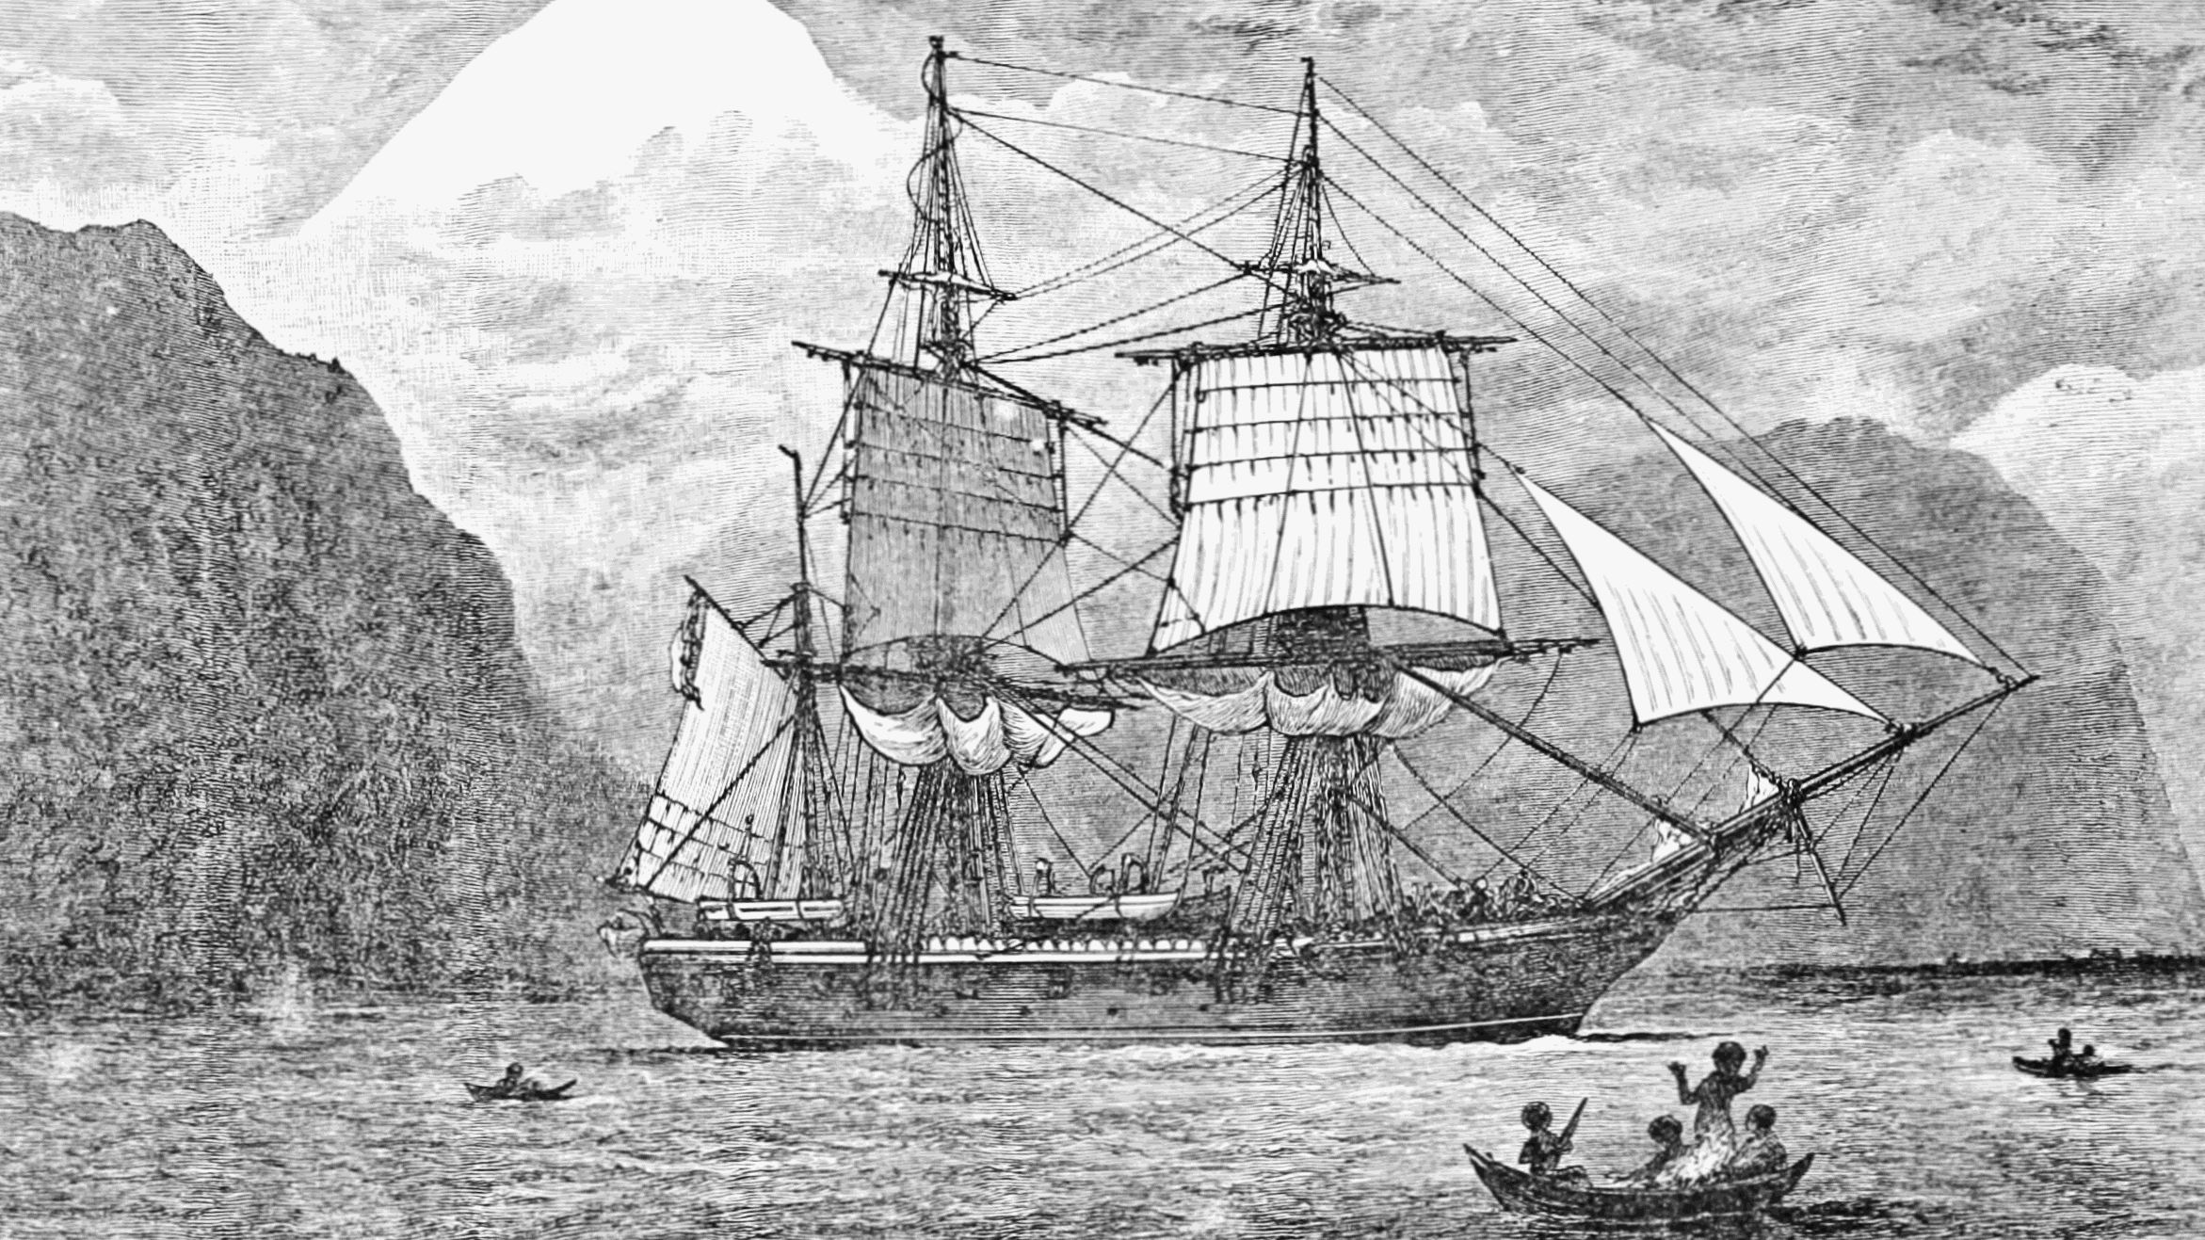
Notes:
HMS Beagle, Galapagos, finches

Slide 43
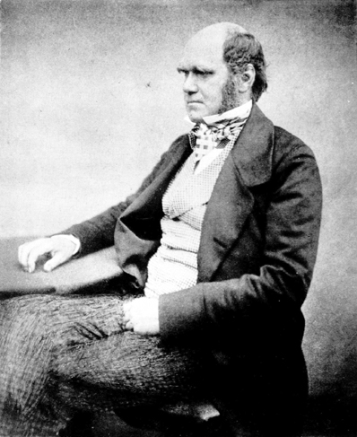
Notes:
Darwin

Slide 44
Notes:
Paradigm shift – revolutionary crustaceans?

