Slide 1
“10,000 deployments to our website per day…”
The Skyscanner Journey So Far
Stuart Davidson
QCon 2018

Slide 2
“10,000 deployments to our website per day…”
The Skyscanner Journey So Far
Stuart Davidson
QCon 2018

Slide 4
Introduction
@spedge
Engineering Manager
Development Mechanics (DMX)
Deployment & Orchestration (DO)

Slide 5
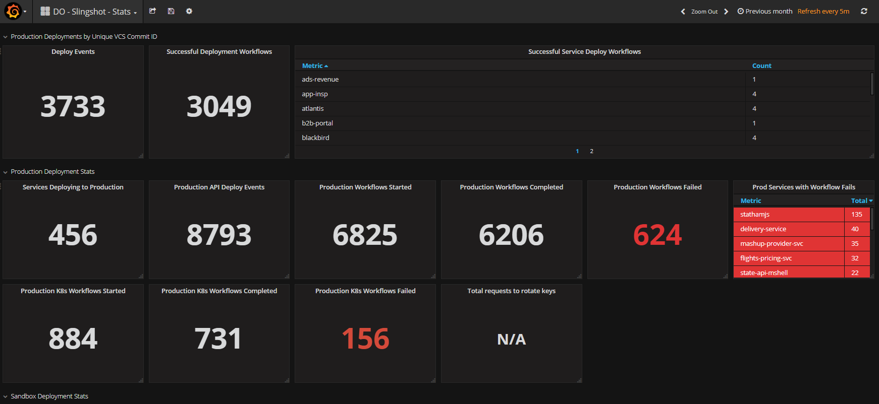

Slide 6
Once upon a time…
I want you to create a platform that will deploy 10,000 changes a day to our website.
Uhm. I think you mean 10?
Nope, I mean 10,000.
Ok, err. I think you mean a year?
Nope, I mean 10,000 per day. Every day.
Oooookay. Right. So…uh….any idea how?
Nope, that’s what we pay for you for. But if you need anything, any support or any messaging – let me know.
….Gin?

Slide 7
“The Jenkins Paradox”
Q: How did we find out that we were a strategic enabler?
A: When it became apparent we were a strategic roadblock…

Slide 8
Schedulers

Slide 9
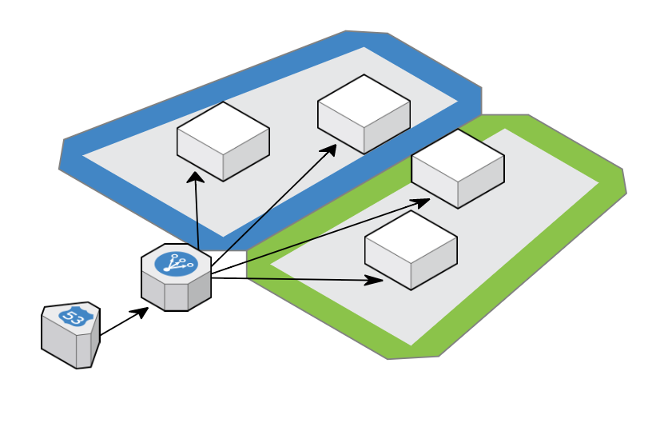
The BIG PLAN

Slide 10
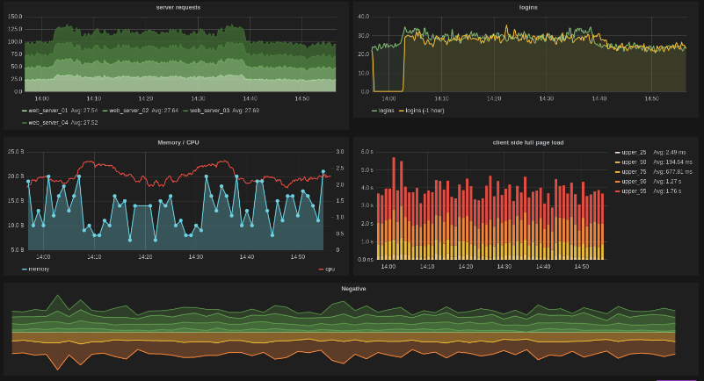
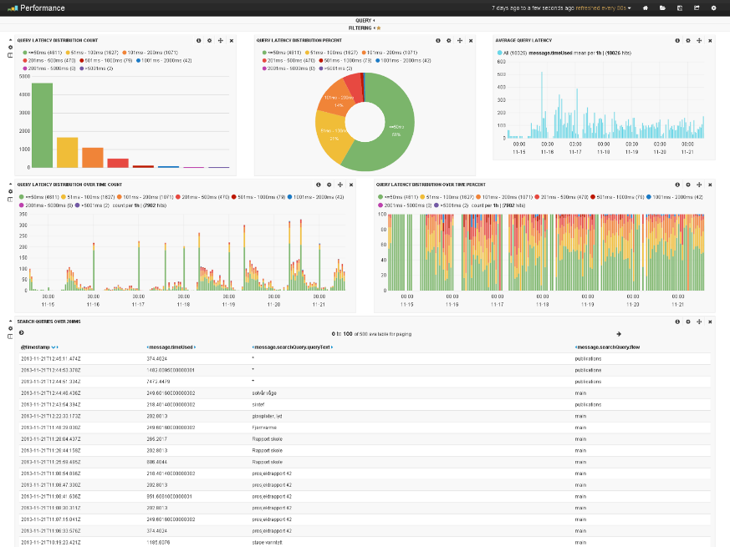
Slingshot Service
HAProxy
Your Awesome Idea
v0.1
Heka

Slide 11
High-Level Architecture
Build
Package
Publish
API
SWF
Gitlab
ECS
Your Service
Lambda
Continuous Integration
Continuous Deployment
“From source to service in zero clicks…”

Slide 12
Registry
Your image registry is one of the most important parts of your infrastructure...
It will lull you into a false sense of security when things are going well...
But when you need it…
When you really, really need it..
Unless you are prepared…
It WILL fail you.

Slide 13
Does it scale?

Slide 14
What’s Next?
Re-evaluating any tooling that isn’t cloud native.
Getting the hang of multi-tenancy hosting
Working harder at reducing technical obsolescence

Slide 15
Deep Thought
Enablement isn’t doing something for a team, enablement is helping them do it themselves.
If you are experimenting with a new tool or process – find the quickest and easiest one to use. From that, learn about what you actually need.
The tools and systems that you’ve invested so much time in today will be considered obsolete tomorrow. Accept that as part of what you do as professional engineers – it’s part of the joy of software.
A journey of a thousand miles starts with a single step.

