Slide 1
HIGH PERFORMANCE CONTINUOUS DELIVERY
VERSIONING AND RELEASE MANAGEMENT ALIGNED

Slide 2

About me
Sven Erik Knop, Perforce Software Ltd
  Senior Technical Specialist
Joined Perforce as a Consultant in 2008
Extensive knowledge in deploying and optimizing
Perforce installations and processes
Background in Development and Databases
Author of P4Python

Slide 3
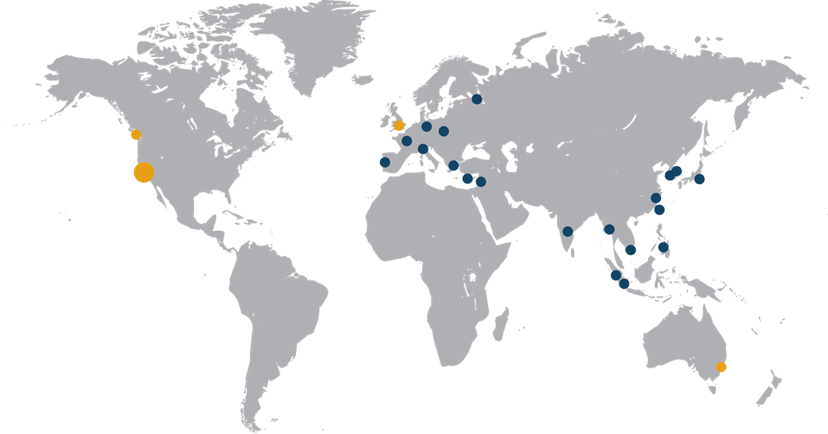
What we do
Perforce helps delivery teams build complex products collaboratively, securely and efficiently.
Commonly used for
  Software
  Games
  Electronics
  Animations
  Chipsets
  Medical Devices
  IoT
Global 24x7 Support
Collaborative IP Creation
Notes:
Perforce currently provides the world’s fastest and most scalable version management and collaboration platform.
Put simply, we let companies track versions, or iterations, of their software assets as they’re developed.
It’s not just source code we version. Far from it.
We also do the same thing for binary files and digital assets – pictures, web sites, audio – almost anything you can create.
Question to ask the audience – (especially executives) – are you familiar with version management – (if not, walk them through a customer example)
If it’s digital and being developed, refined or changed by individuals or teams, Perforce can capture and version every amendment made.
Right now, 350,000 users across 5,500 companies trust Perforce Software to safely version their code, assets and intellectual property.

Slide 4


















Market Leaders Trust Perforce
Chips
Games
& Animation
Cloud/SW
Electronics
Systems
Automotive
9,500 users
500+ terabytes
5,000+ users
coders & designers
2,500 users
10,000,000
Perforce xact/day
20,000 users
Everything!
11,000+ users
Notes:
Opportunity to poll – how many of you use products from samsung? How many from apple? How many use Amazon? How many use services from google? You touch products built on Perforce, daily…
Click….
We have 10000+ customers across the globe. This is a proven platform for delivering a diverse set of products.

Slide 5
Agenda
Why continuous integration (CI)?
Why continuous delivery (CD)?
And what does this have to do with Perforce?

Slide 6
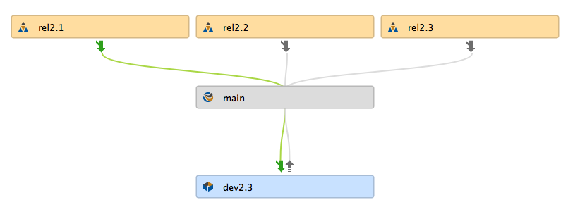

Why Continuous Integration?
It’s all about the mainline (master, trunk ...)

Slide 7
Mainline
The mainline model:
  The source of all branches
  The ultimate target of all changes
The mainline should be:
  Always buildable
  Always testable
  Always deployable
  Ideal: Always deliverable

Slide 8
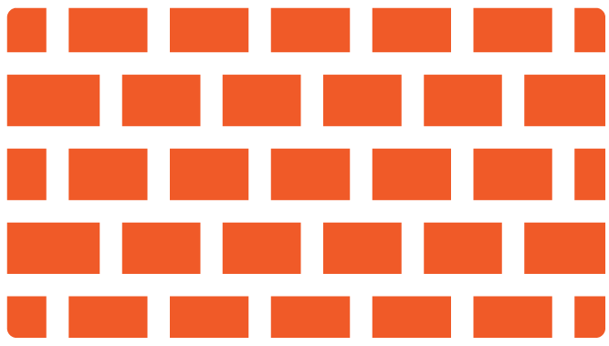
Why Continuous Delivery?
Dev
QA
Pre
Production
Production
Lack of communication between teams
Each team uses a different data repository
Environments can be substantially different
Software deployed in different ways for each environment

Slide 9
Continuous Delivery
Deliver working product to users as quickly as possible
Every change (check-in) leads to a potential release
Give business the option to release
– what, when, to whom
A change in process, and culture
Continuous Delivery
Reqs
Dev
Test
Integrate
Deploy
PIPELINE
Notes:
In order to achieve continuous delivery of software all teams involved in creating and releasing software to customers need to work in an agile manner. Repeatable processes are key to success. This involves both culture and process change and affects all teams involved. If every change could lead to a potential release there needs to be a high level of trust between all parties involves. All teams need to have a common goal of getting quality products to users faster.

Slide 10

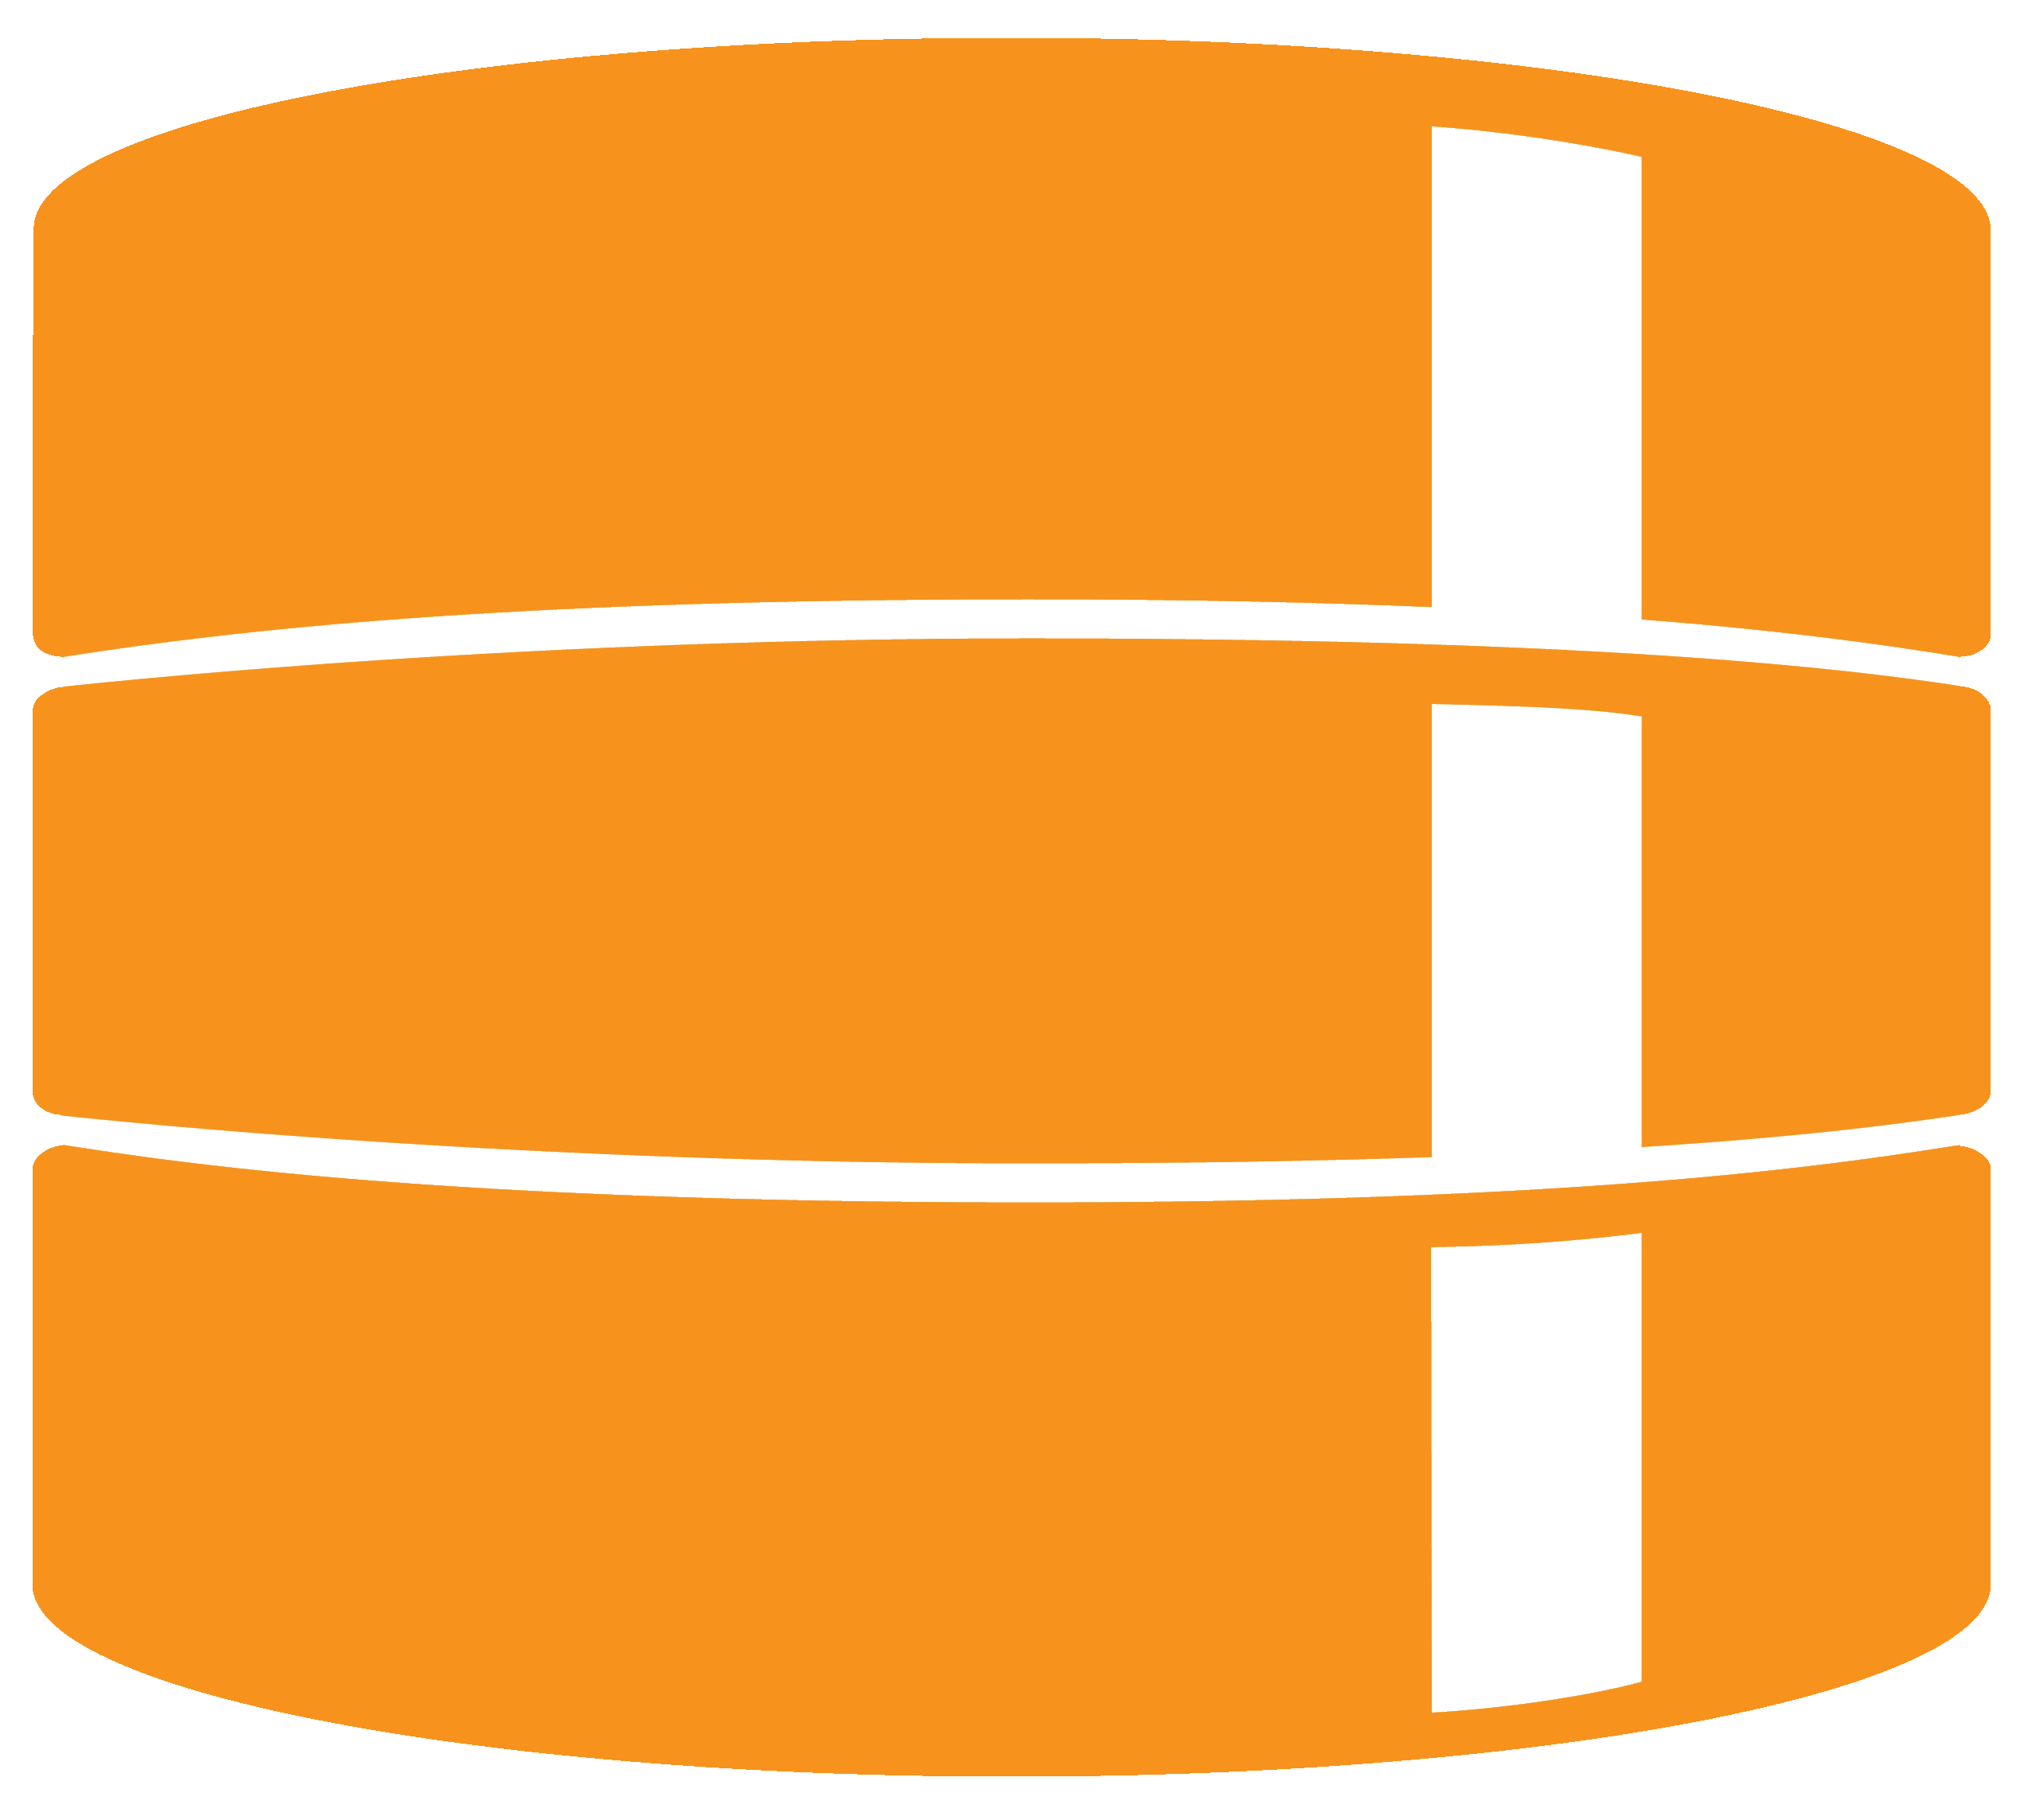
Best practices for success
Team Collaboration
Flexible Workflow
Complete Visibility
COORDINATE TEAMS
(design, dev, release, devops, etc.)
PIPELINE
COORDINATE ASSETS
(code, scripts, artwork, binaries, etc.)
Version Everything
Universal Security
Detailed History
Notes:
There is no “one true way” to do continuous delivery, but there are some best practices that should be followed.
Teams need to be collaborative. Responsibility of developers and QA does not end until after software is successfully running in production.
There needs to be a flexible workflow, tools amd processes vary, flexibility without sacrificing repeatability is key.
Due to a potentially huge increase in the number of product releases it is important to know what work is in progress and how that work relates to requirements and code.
Best practices dictate versioning everything. Anything that has been deployed to production should be able to be recreated in the future if needed. This can prove challenging in many environments.
Delivering quality products quickly relies on extensive collaboration. This requires granting access to intellectual property to a wider range of people which maintaining control and auditability.
It is critically important that in the event that something goes wrong, and things do go wrong from time to time, that there is detailed history of what has happened to your products. When was something updated? Who updated it? Why was the change made? Who accessed a file?

Slide 11



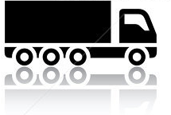
Just-in-time delivery

Slide 12
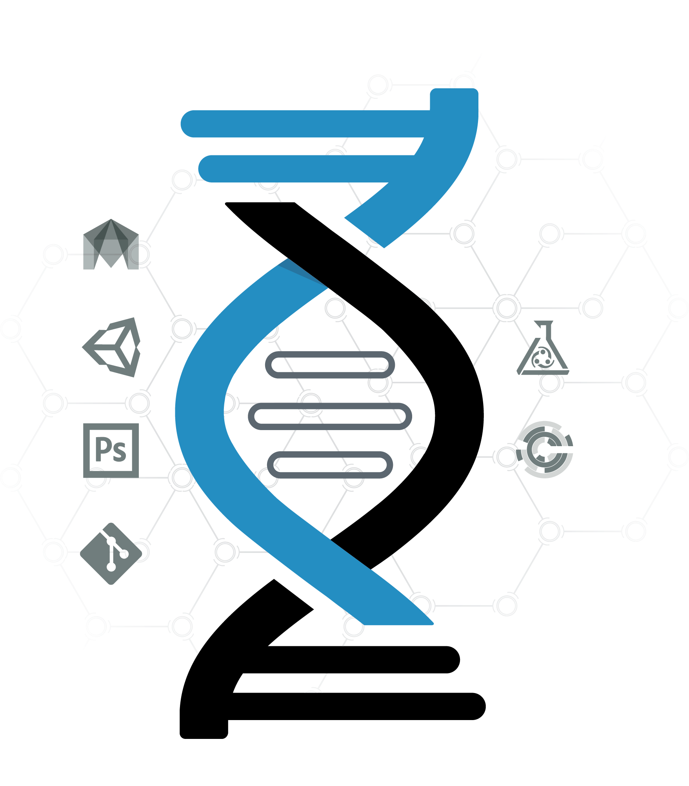
Perforce’s solution: Helix

Slide 13

Continuous Delivery Demo
Demo
Notes:
I’m now going to give you an overview of what we will show in the demo.

Slide 14
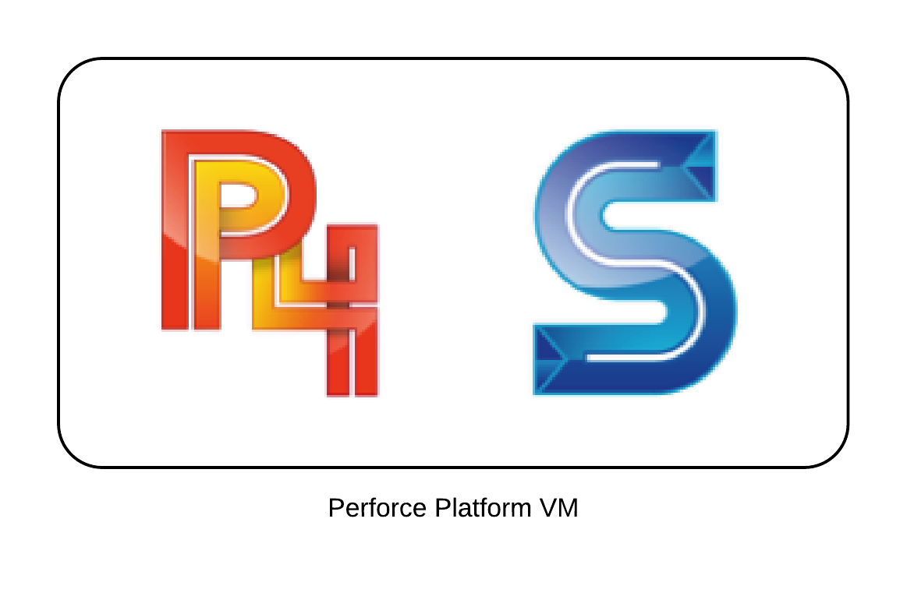
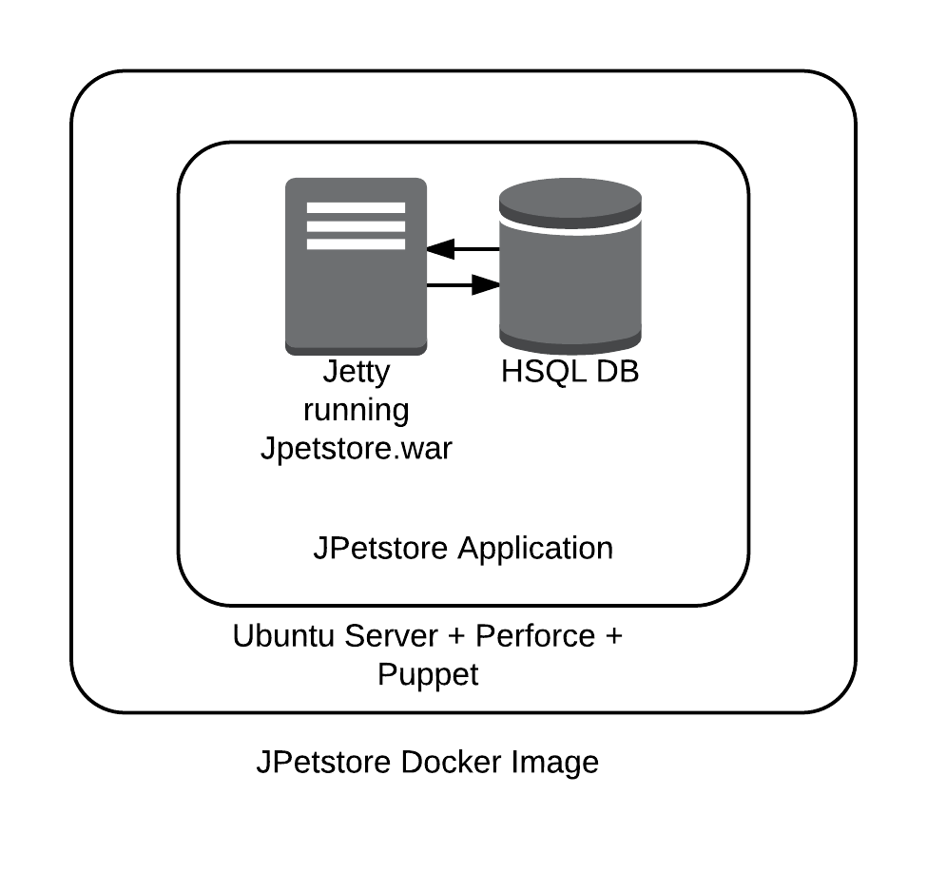
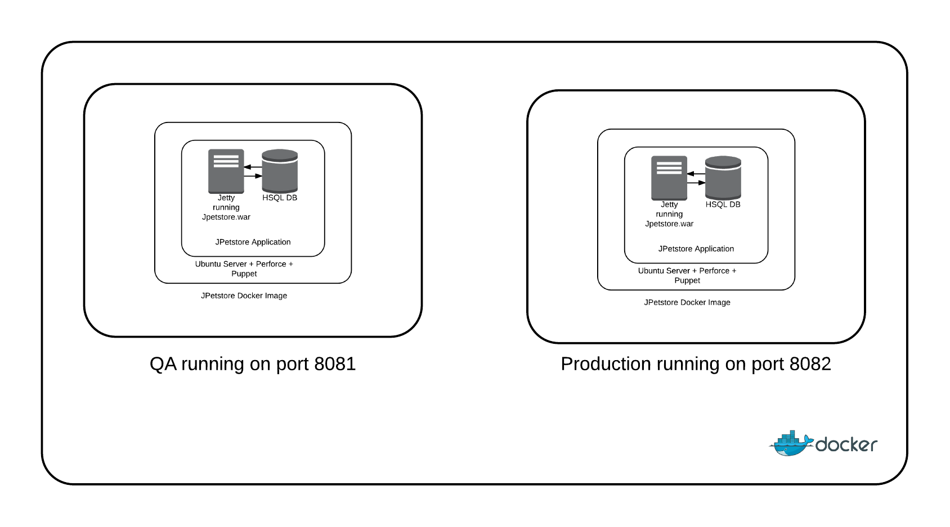
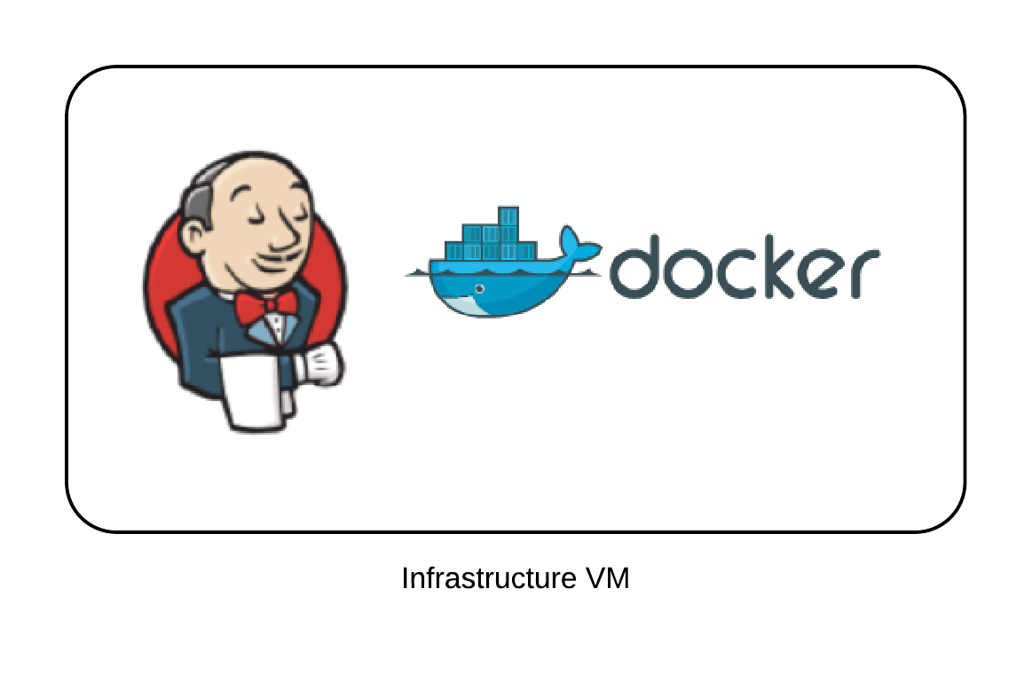
Demo environment
Perforce platform VM stores artifacts and code review data
Infrastructure VM manages the pipeline, builds artifacts and hosts environments in docker
Docker image for Jpetstore is deployed to QA and Production environments
Notes:
We have used some commonly used technologies as part of our stack. Using Puppet and Docker to define our infrastructure as code in conjunction with the Perforce platform made producing easily reproducible environments simple.

Slide 15
Demo scenario
Edit the slider to include two more photos and deliver to production using the Continuous Delivery pipeline
Notes:
I’m going to make a change to our web application. I’m going to change the side menu background color from yellow to white.

Slide 16
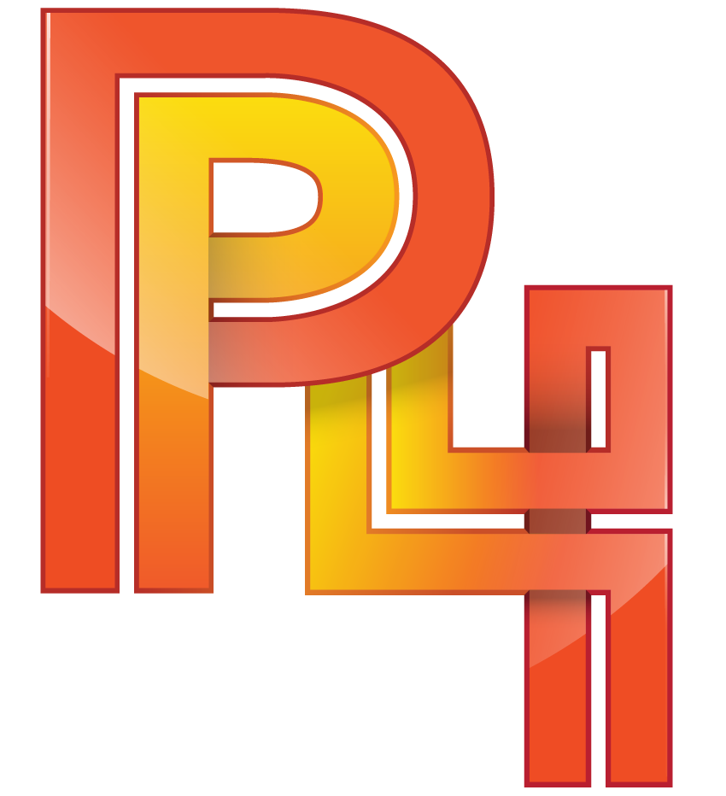
Our pipeline
Auto
Auto
Manual
Application checked out, built and checked back in and labeled
Artifacts retrieved from Perforce and build into docker container and checked back in
Docker container deployed to QA for testing
Docker container deployed to production for testing
Notes:
The continuous delivery pipeline is modeled in Jenkins using the build pipeline plugin. This approach is a common approach but other solutions can be used with the perforce platform to achieve the same results. Our pipeline uses both automated and manual transitions to move between stages.

Slide 17
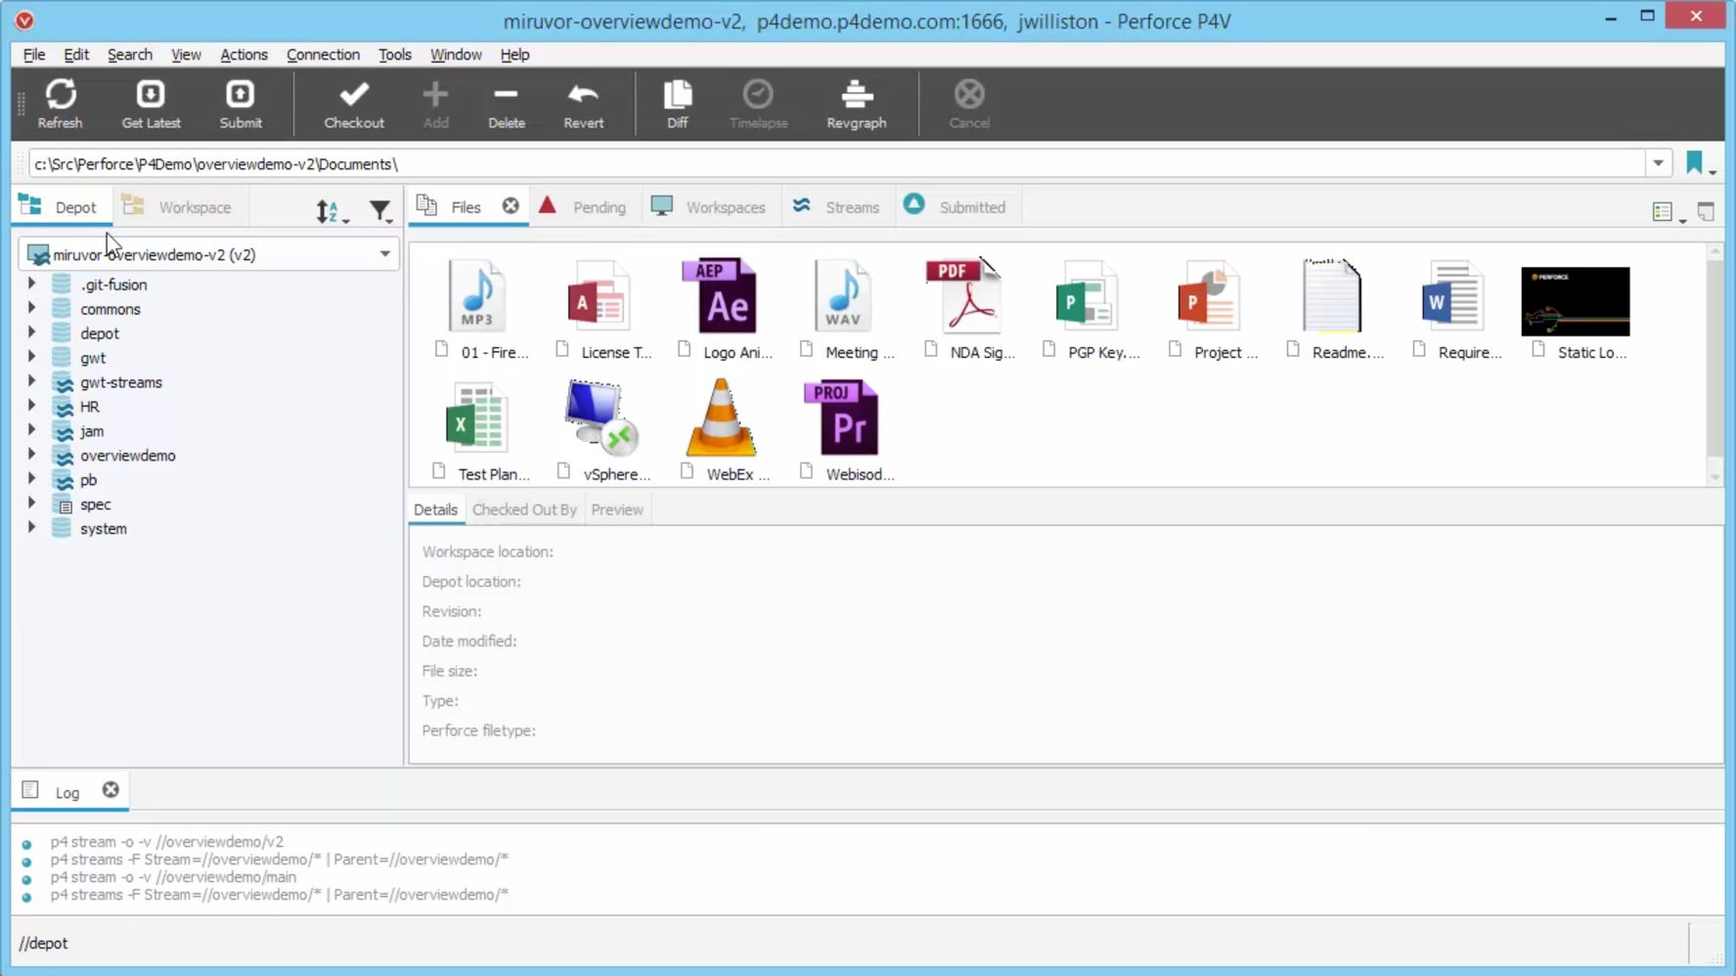
Versioning pipeline artifacts
Perforce can store data of any type and size. In this demo scenario
  Application Source
  SQL Scripts
  Graphics Files
  Build Artifacts
  Deployment images
  Environment Definitions
  Infrastructure as code
Notes:
All artifacts used during the process of creating, building and deploying the JPetStore application are stored in version control.

Slide 18
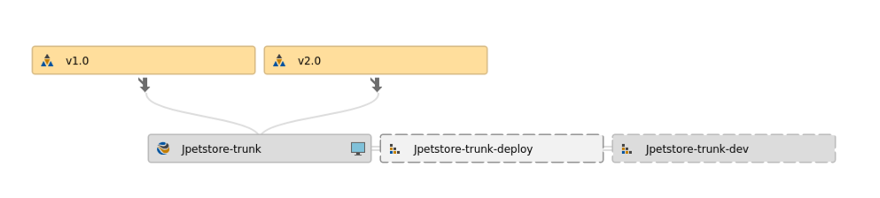
Developer workflow
Working with files is optimized for Continuous Delivery
  Select stream to work from and start working
  Sync only the content needed for a task
  Code committed to trunk
Notes:
The demo uses trunk based development which is an approach commonly used with continuous delivery. When using trunk based development there is an emphasis on frequent, small checkins that are high quality. Don’t break trunk, if you do fixing it is your first priority!

Slide 19
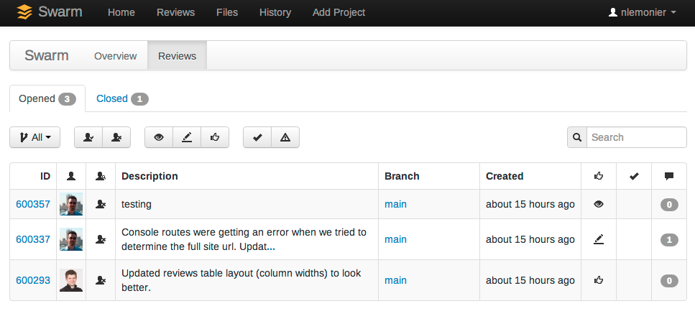
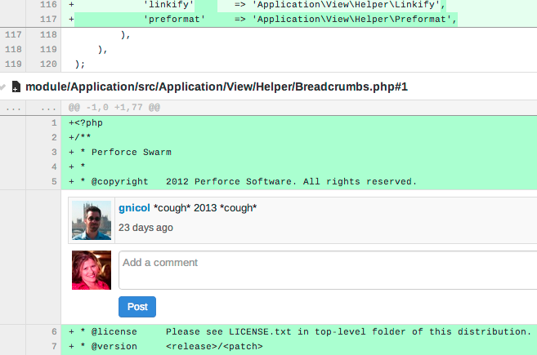
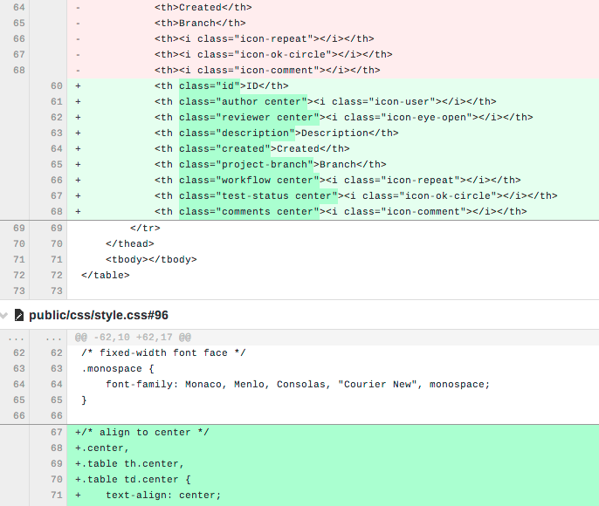
Continuous code reviews
Pre and post-commit code
(& doc) reviews across lifecycle
Inline conversations and diffs
Built-in hooks for pre-flight testing and deployment
Dashboard for continuous delivery across multiple projects
Across Git and Perforce
Notes:
In order to help ensure quality code is checked into trunk we’ll show how code reviews can easily be added to your development process. Code reviews can be applied to many types of content and can also be used for things like test automation scripts, infrastructure as code and so on.

Slide 20
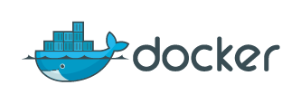



Successful Implementation of a Continuous Delivery Pipeline
Integrate
Test
Build
Deploy
Release
High velocity build, test and deploy lifecycle
Increased developer onus, unbreakable builds
No room for “it works on my machine”
Builds tested on production like environments
Deployment to internal or external users
Version Control
Notes:
While there are many discussions ongoing on the best models for implementing CD, here is what we see in our most successful customers –
Versioning is used for all managing iterations of all aspects of the product, including code and content
Every change is recorded, even if it is thought of as being irrelevant by the individual
Automation is used at all stages to build, test, and deploy
Managers have visibility into all aspects of development, developers adopt an open culture of collaboration
Having a single hub of information makes delivery possible

Slide 21
Thank You!
sknop@perforce.com / @p4sven

